Slide 1
Birmingham 2030 Strategic Framework

Slide 2


Birmingham 2030 Strategic Framework
www.bham.ac.uk/2030

Slide 3


Birmingham 2030: Our ambition
Over the next decade, our aspiration is to establish Birmingham in the top 50 of the world’s leading universities.
Our Strategic Framework sets out how we will pursue this highly-challenging ambition. With world-class research and outstanding global education as our core mission, we will strive to increase the volume and quality of our research to make an even greater difference to the world around us. We will be the UK’s exemplary civic university, remaining firmly committed to our foundations in the highly diverse communities, people, and economy of the city of Birmingham and the West Midlands. We will maintain our financial strength to enable investment in our academic mission, allowing us to make the most of the extensive breadth and quality of the University’s academic disciplines.
We will take full advantage of our signature projects, innovation sites, and capital developments to make a lasting impact in all the regions in which we operate, and globally.

Slide 4
Our ambition is bold and clear: to be recognised among the world’s top 50 universities.
Our Strategic Framework charts our ambition, rooted in 125 years of civic impact. It centres on world‑class research, transformative education, community engagement and local civic leadership.

Slide 5






Our core pillars
Research
Education
Engagement and impact
A globally leading university is built on a foundation of world-class research.
A University of Birmingham education is transformative.
We are committed to delivering meaningful change.
Civic and global
People and culture
Sustainability
We are proud to be a university of Birmingham, for Birmingham.
Our people, and our collective values, are core to our University and its success.
As a University founded on social responsibility, we are committed to addressing the sustainability and climate challenges facing our world.

Slide 6
Our core pillars
Research
Education
Engagement and impact
Civic and global
People and culture
Sustainability

Slide 7

Research
A globally leading university is built on a foundation of world-class research.
Our goals
Amplify the scale, visibility, and impact of our research.
Lead interdisciplinary solutions to global challenges.
Empower a culture of research excellence, innovation and inclusion.
Our key priorities
Increasing the volume and diversity of our research funding.
Developing academic leadership and innovation.
Building a supportive and high-performing research culture.
Embedding impact across the research lifecycle.
Realising impact through our interdisciplinary capabilities.
Driving a meaningful and mutually enriching relationship between research and education.

Slide 8
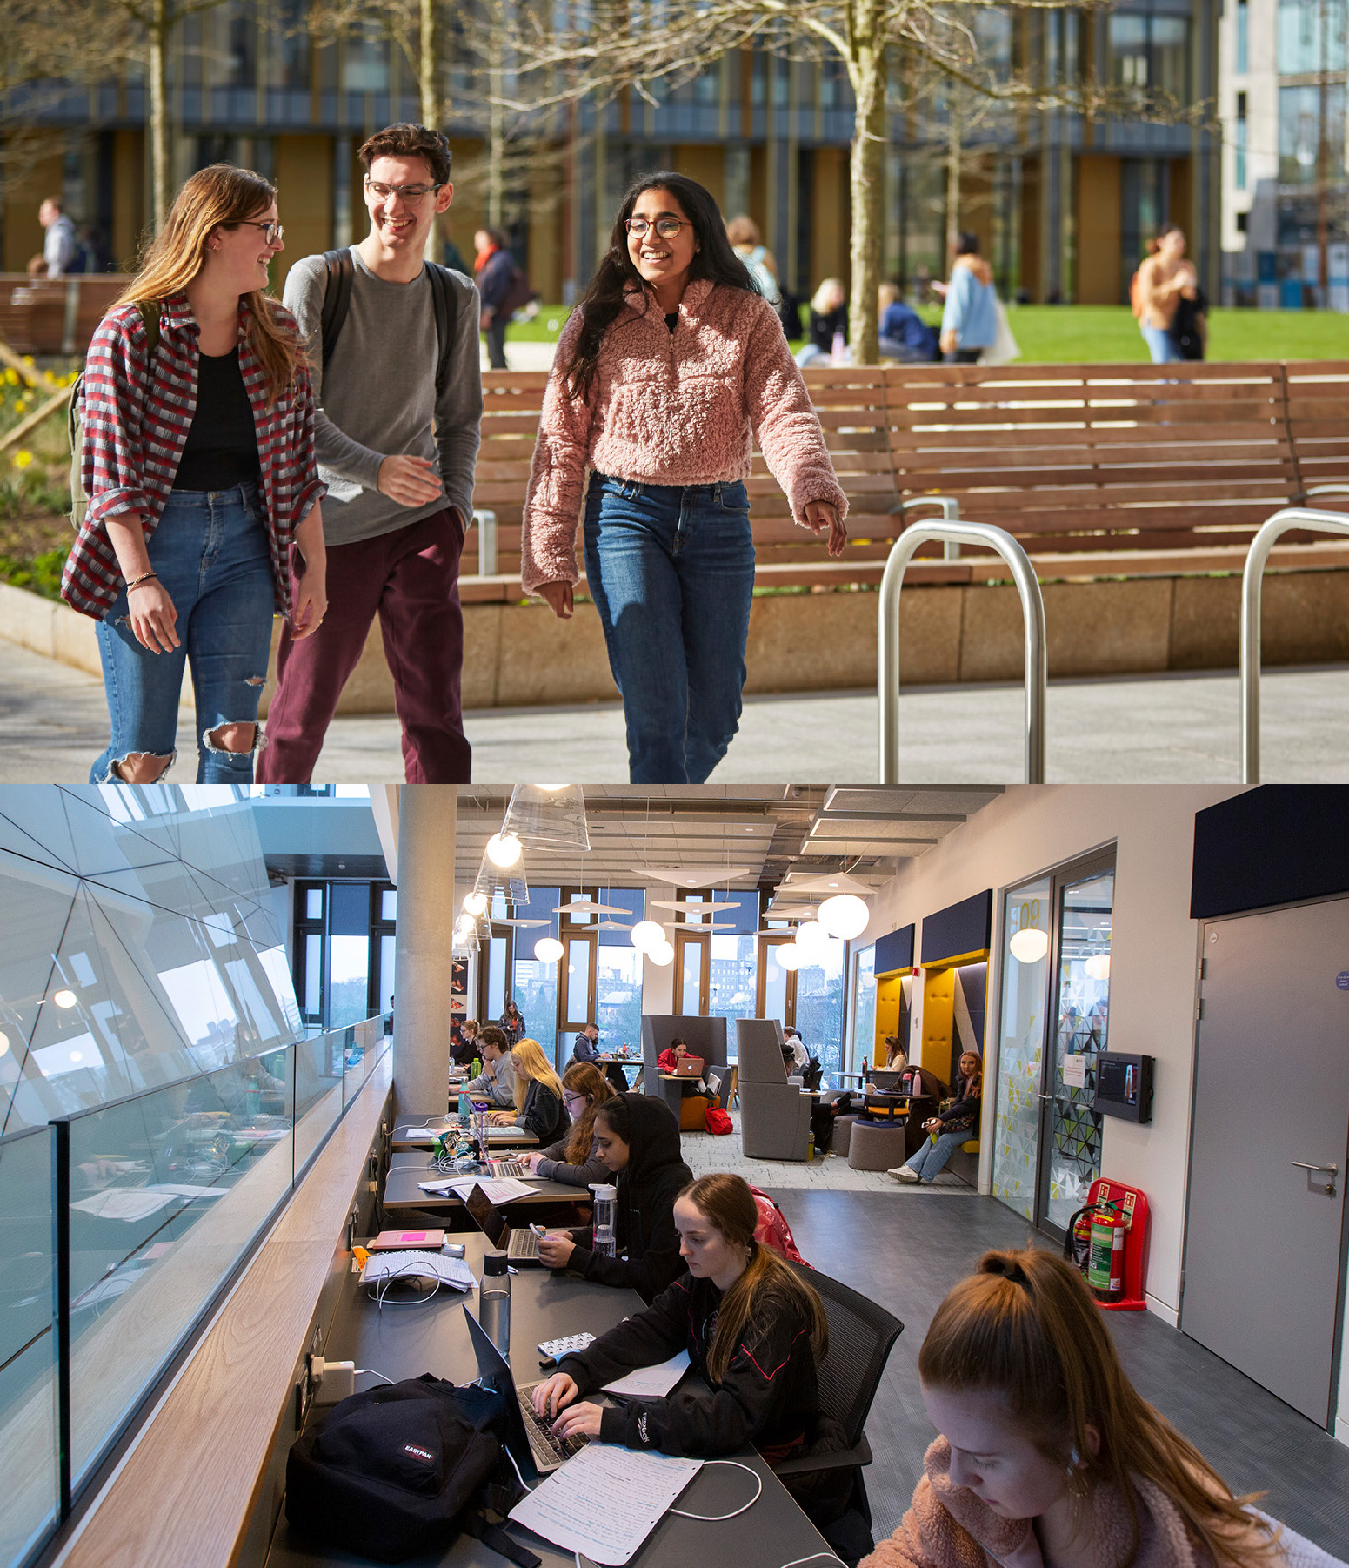
Education
A University of Birmingham education is transformative.
Our goals
Deliver a high-quality, transformative education, enabling student success.
Develop confident, capable graduates able to thrive in our evolving world.
Create an inspiring learning community which attracts and supports diverse learners.
Empower a culture of excellence in teaching practice and education leadership.
Our key priorities
Delivering a distinctive and transformational approach to education and assessment.
Evolving our education portfolio to meet the needs of future learners.
Improve academic achievement, career readiness, and wellbeing for our student community.
Supporting professional development to drive excellence in leadership.
Embracing digital learning technologies and efficient teaching practices.

Slide 9
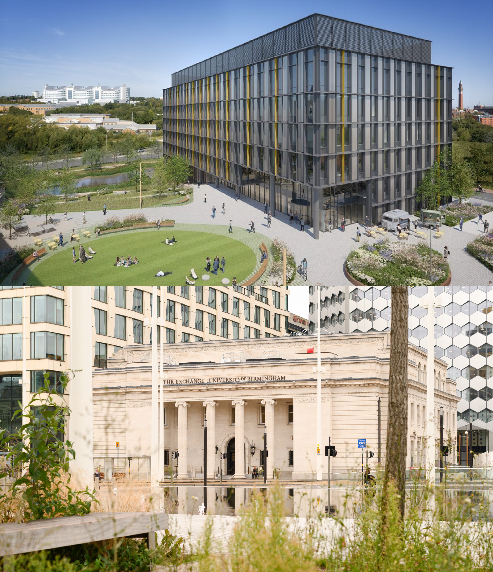
Engagement and impact
We are committed to delivering meaningful change.
Our goals
Deliver societal benefit in partnership with communities, industry, and government.
Shape future industries and support inclusive economic growth.
Drive policy change to improve quality of life and wellbeing.
Our key priorities
Using our expertise, sites, and assets to strengthen industry networks.
Working with industrial partners to realise policy change.
Working with our local and global communities through accessible, participatory activities.
Strengthening and expanding our innovation partnerships.
Advancing Innovation Districts and creative economies.

Slide 10

People and culture
Our people, and our collective values, are core to our University and its success.
Our goals
Empower every staff member to thrive through an inclusive culture, clear opportunities, and the right support.
Build a workplace where people feel recognised, inspired, and proud to belong.
Foster a culture of excellence where we set high expectations for ourselves and each other.
Our key priorities
Attracting, developing and retaining great people.
Building a supportive and high-performing culture to enable our staff to flourish.
Developing leaders at every level.
Delivering the aims of our Equality, Diversity and Inclusion Strategy.
Embedding a culture that supports smarter working and stronger wellbeing.
Embedding our values across the University.

Slide 11
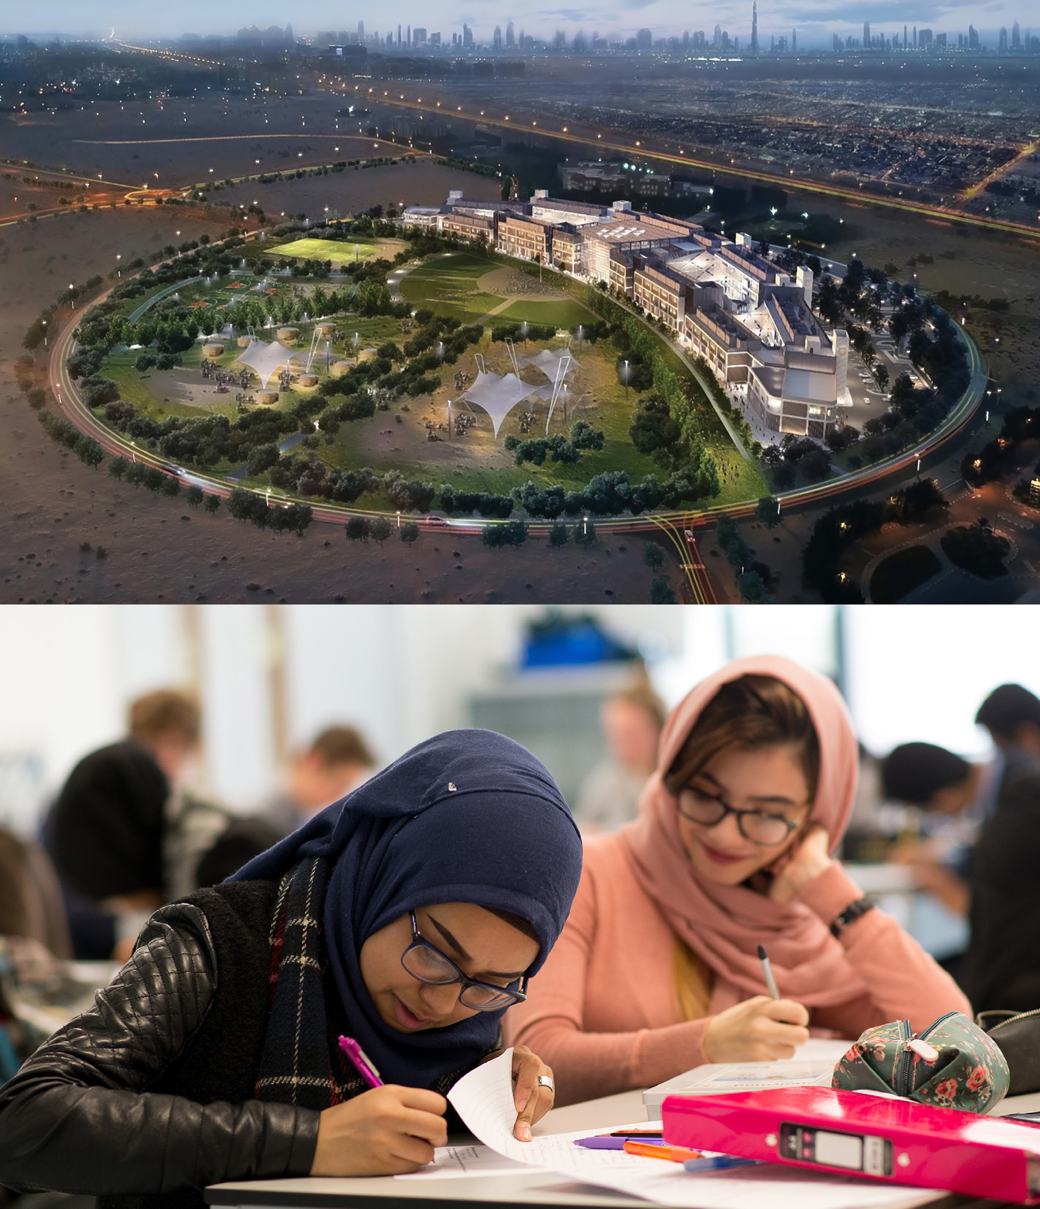
Civic and global
We are proud to be a university of Birmingham, for Birmingham.
Our goals
Be recognised as a top 50 university with global influence.
Attract the best students, staff, and partners.
Be a key driver for the economic, social and environmental growth of Birmingham and Dubai.
Our key priorities
Attracting, developing and retaining great people.
Extending our global reach and reputation.
Growing our global presence through partnerships.
Expanding international student recruitment and mobility.
Championing Birmingham on the global stage.
Contributing to regional growth and skills development.
Supporting people, businesses and infrastructure.

Slide 12
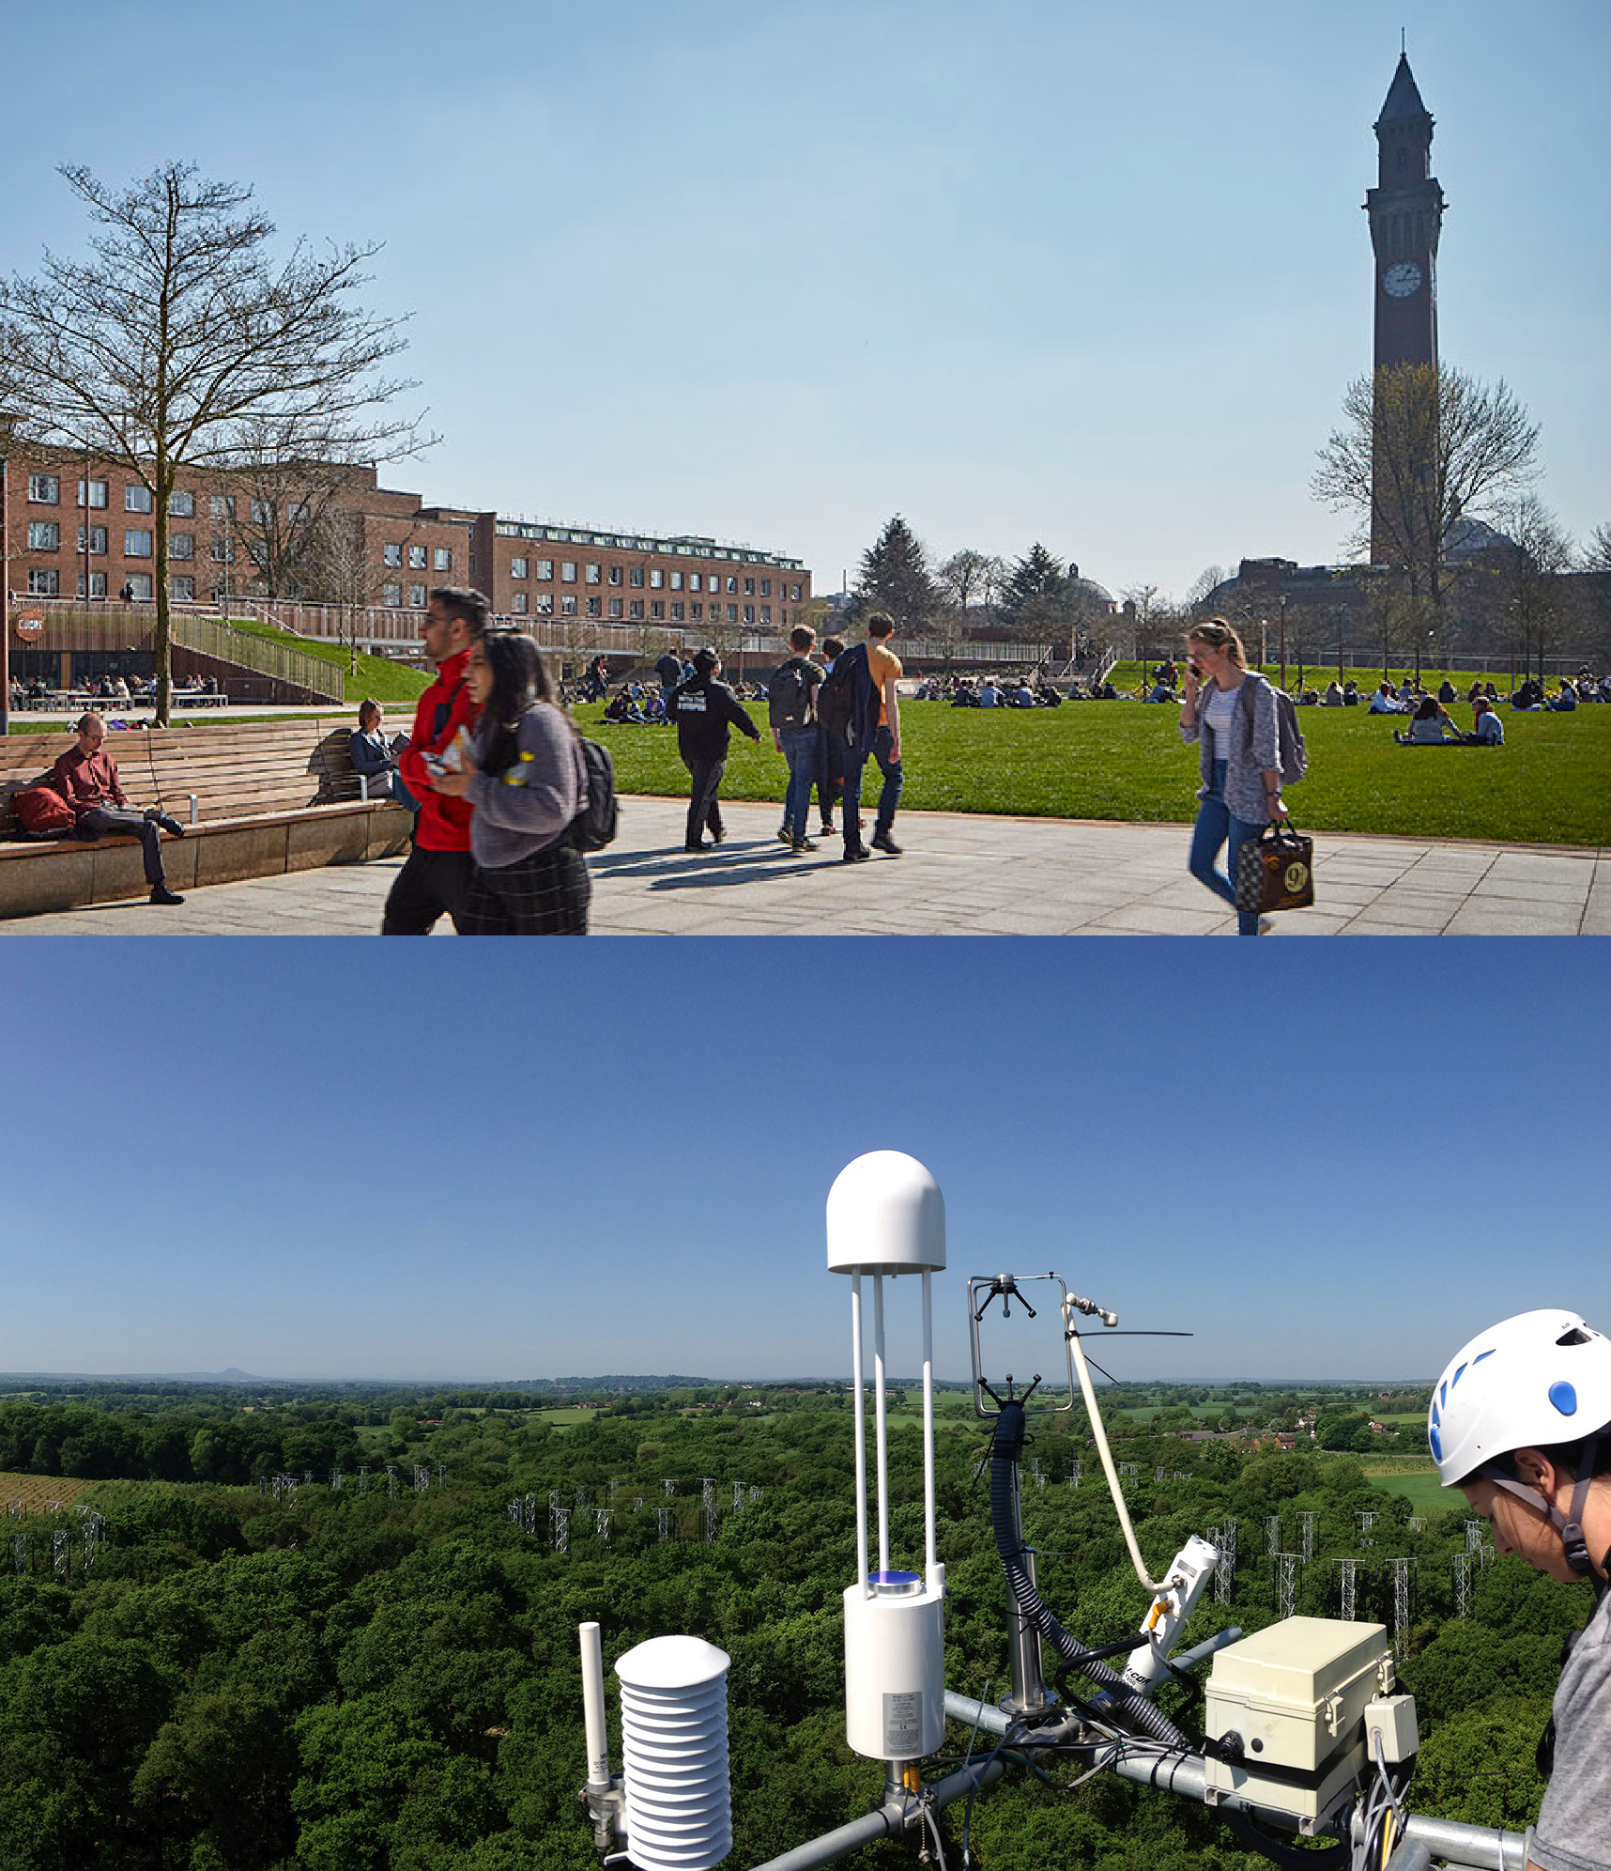
Sustainability
As a University founded on social responsibility, we are committed to addressing the sustainability and climate challenges facing our world.
Our goals
Embed sustainability across our research, education and global impact.
Lead by example though environmentally responsible practices.
Co-create sustainable solutions with lasting impact beyond our campus.
Our key priorities
Making major contributions to research in sustainability and climate change action.
Integrating sustainability into our academic programmes.
Adopting environmentally responsible practices across our University.
Embedding a culture of sustainability within and beyond our campus.

Slide 13
Embedding our values across the University
Our culture is based on our shared values, which we seek to embody throughout the organisation:
Ambitious
Collaborative
Responsible
Open
Innovative
The major challenges facing our city, nation, and the world cannot be solved if we act alone. We enhance our research and education by pursuing creative partnerships within and beyond the University.
We operate with transparency, trust, and respect. We value our role as an anchor institution for Birmingham and growing our contribution to Dubai. We strive to be an excellent employer, to reduce inequalities in access to education, and to place sustainability at the heart of our work.
We welcome colleagues, collaborators, and students from across the world to work and study with us. We are committed to academic freedom, freedom of speech, and equality of opportunity for all. We expect everyone to act with sensitivity, respect, and fairness.
We enjoy being the first to do things. Inspired by our Birmingham heritage, we are resourceful, creative, grounded, and practical, and seek to make a real and positive difference to the world around us.
We are confident in the University of Birmingham and project this globally. We are focused on our goals, are clear about our strengths, and pursue our own direction. We are bold and take intelligent risks.
Universities enduring purpose - https://www.birmingham.ac.uk/about/our-strategy/our-enduring-purpose

Slide 14

Measures of success
Our 2030 Measure of Success quantify our long-term ambition. These are the principal means by which Council will assess progress with the delivery of the Strategic Framework.
More detailed quantitative and qualitative metrics that support these principal measures are integrated into our annual planning process and monitored by University Executive Board.
These measures provide accountability for all areas of the University in contributing to the delivery of our ambitions and will support prioritisation of investment decisions.

Slide 15







Measures of success
Global reputation
We will be recognised amongst the leading universities globally, ranking within the top 50 global institutions in the leading international tables.
Pride in our University
Our staff will be proud to work at the University; our staff engagement, measured via staff surveys, will compare favourably with top national and international employers.
Research quality
The quality of our research will be amongst the best in the UK; our volume of citations per FTE will place us in the top 10 in the UK.
Environment
We will make annual gains in reducing our carbon footprint, aiming to achieve net zero carbon for scope 1 and 2 by 2035 and overall by 2045.
Teaching and learning
Our student experience will be exemplary, ranking within the top quartile in the sector for institutional student satisfaction.
Finance and growth
We will continue to ensure our capacity to invest in our core activities, by maintaining a strong EBITDA, and our overall income per FTE will be amongst the top 10 in the UK.
Graduate success
Our graduates will be amongst the most employable in the UK, ranking within the top 10 institutions in the UK for Graduate Outcomes.

Slide 16
Measures of success
Global reputation
Research quality
Teaching and learning
Graduate success
We will be recognised amongst the leading universities globally, ranking within the top 50 global institutions in the leading international tables.
The quality of our research will be amongst the best in the UK; our volume of citations per FTE will place us in the top 10 in the UK.
Our student experience will be exemplary, ranking within the top quartile in the sector for institutional student satisfaction.
Our graduates will be amongst the most employable in the UK, ranking within the top 10 institutions in the UK for Graduate Outcomes.

Slide 17
Measures of success continued
Pride in our University
Environment
Finance and growth
Our staff will be proud to work at the University; our staff engagement, measured via staff surveys, will compare favourably with top national and international employers.
We will make annual gains in reducing our carbon footprint, aiming to achieve net zero carbon for scope 1 and 2 by 2035 and overall by 2045.
We will continue to ensure our capacity to invest in our core activities, by maintaining a strong EBITDA, and our overall income per FTE will be amongst the top 10 in the UK.

