Slide 1
We advance
We activate

Slide 2
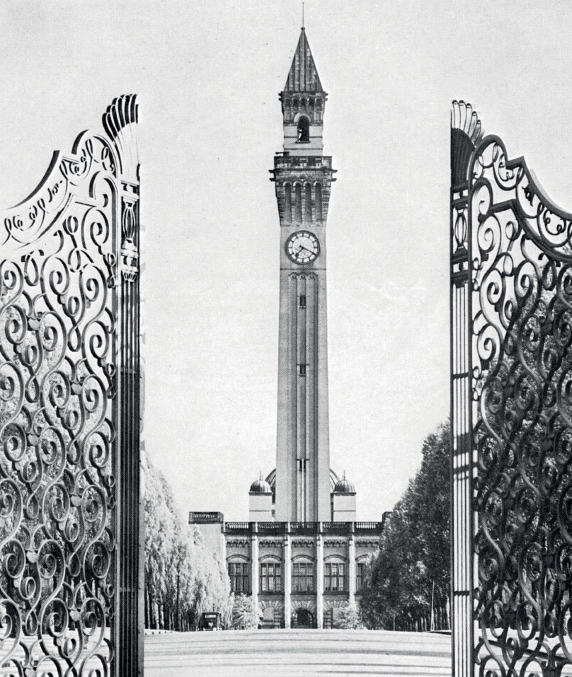
Founded in 1900, as England’s first civic university, where students from all backgrounds were admitted on an
equal basis.
Our global vision is rooted in our civic identity, we positively influence our local communities wherever we operate in the world.
In 2025, we celebrated 125 years of the University of Birmingham. This milestone marks a legacy of driving change and
shaping society.

Slide 3
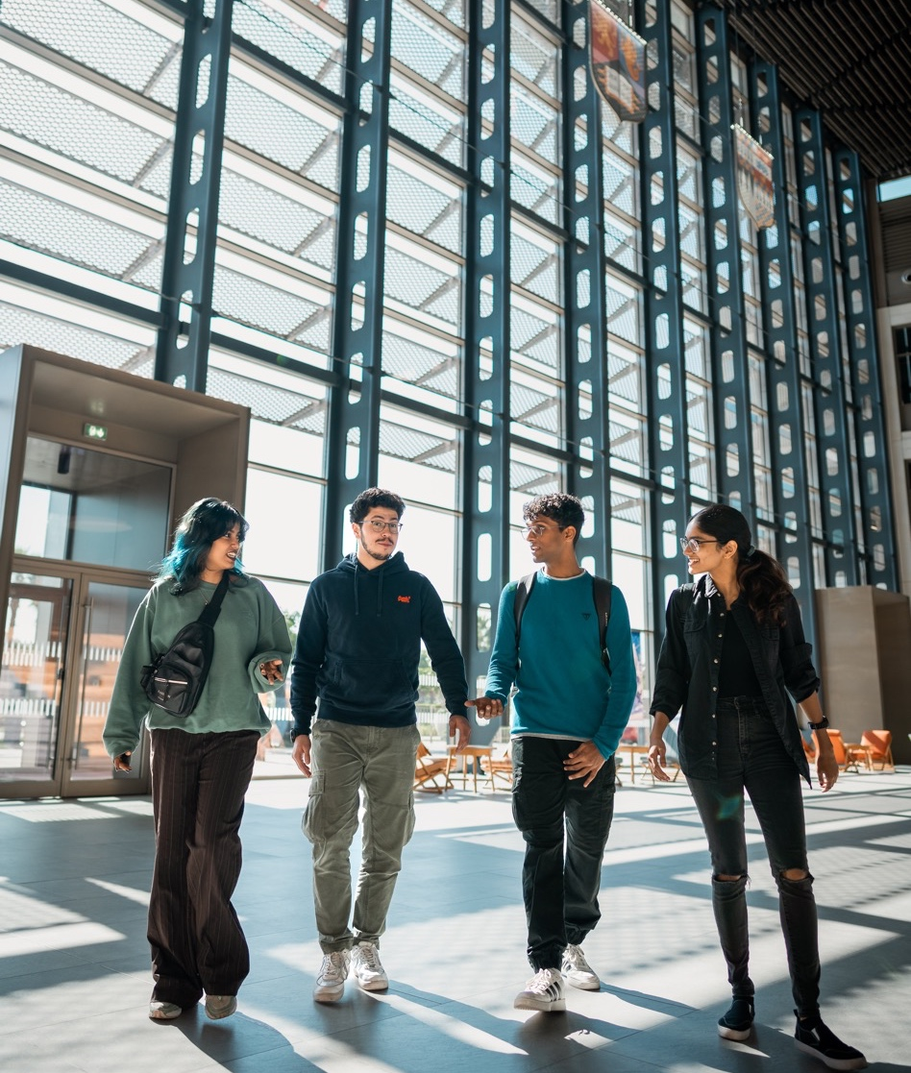
Today we remain committed to our vision of ensuring a diverse, inclusive community.
Co-creating solutions to global challenges through partnership and collaboration across every continent, we have global reach.
Our purpose-built state-of-the-art sustainable smart campus in the heart of the United Arab Emirates.

Slide 4
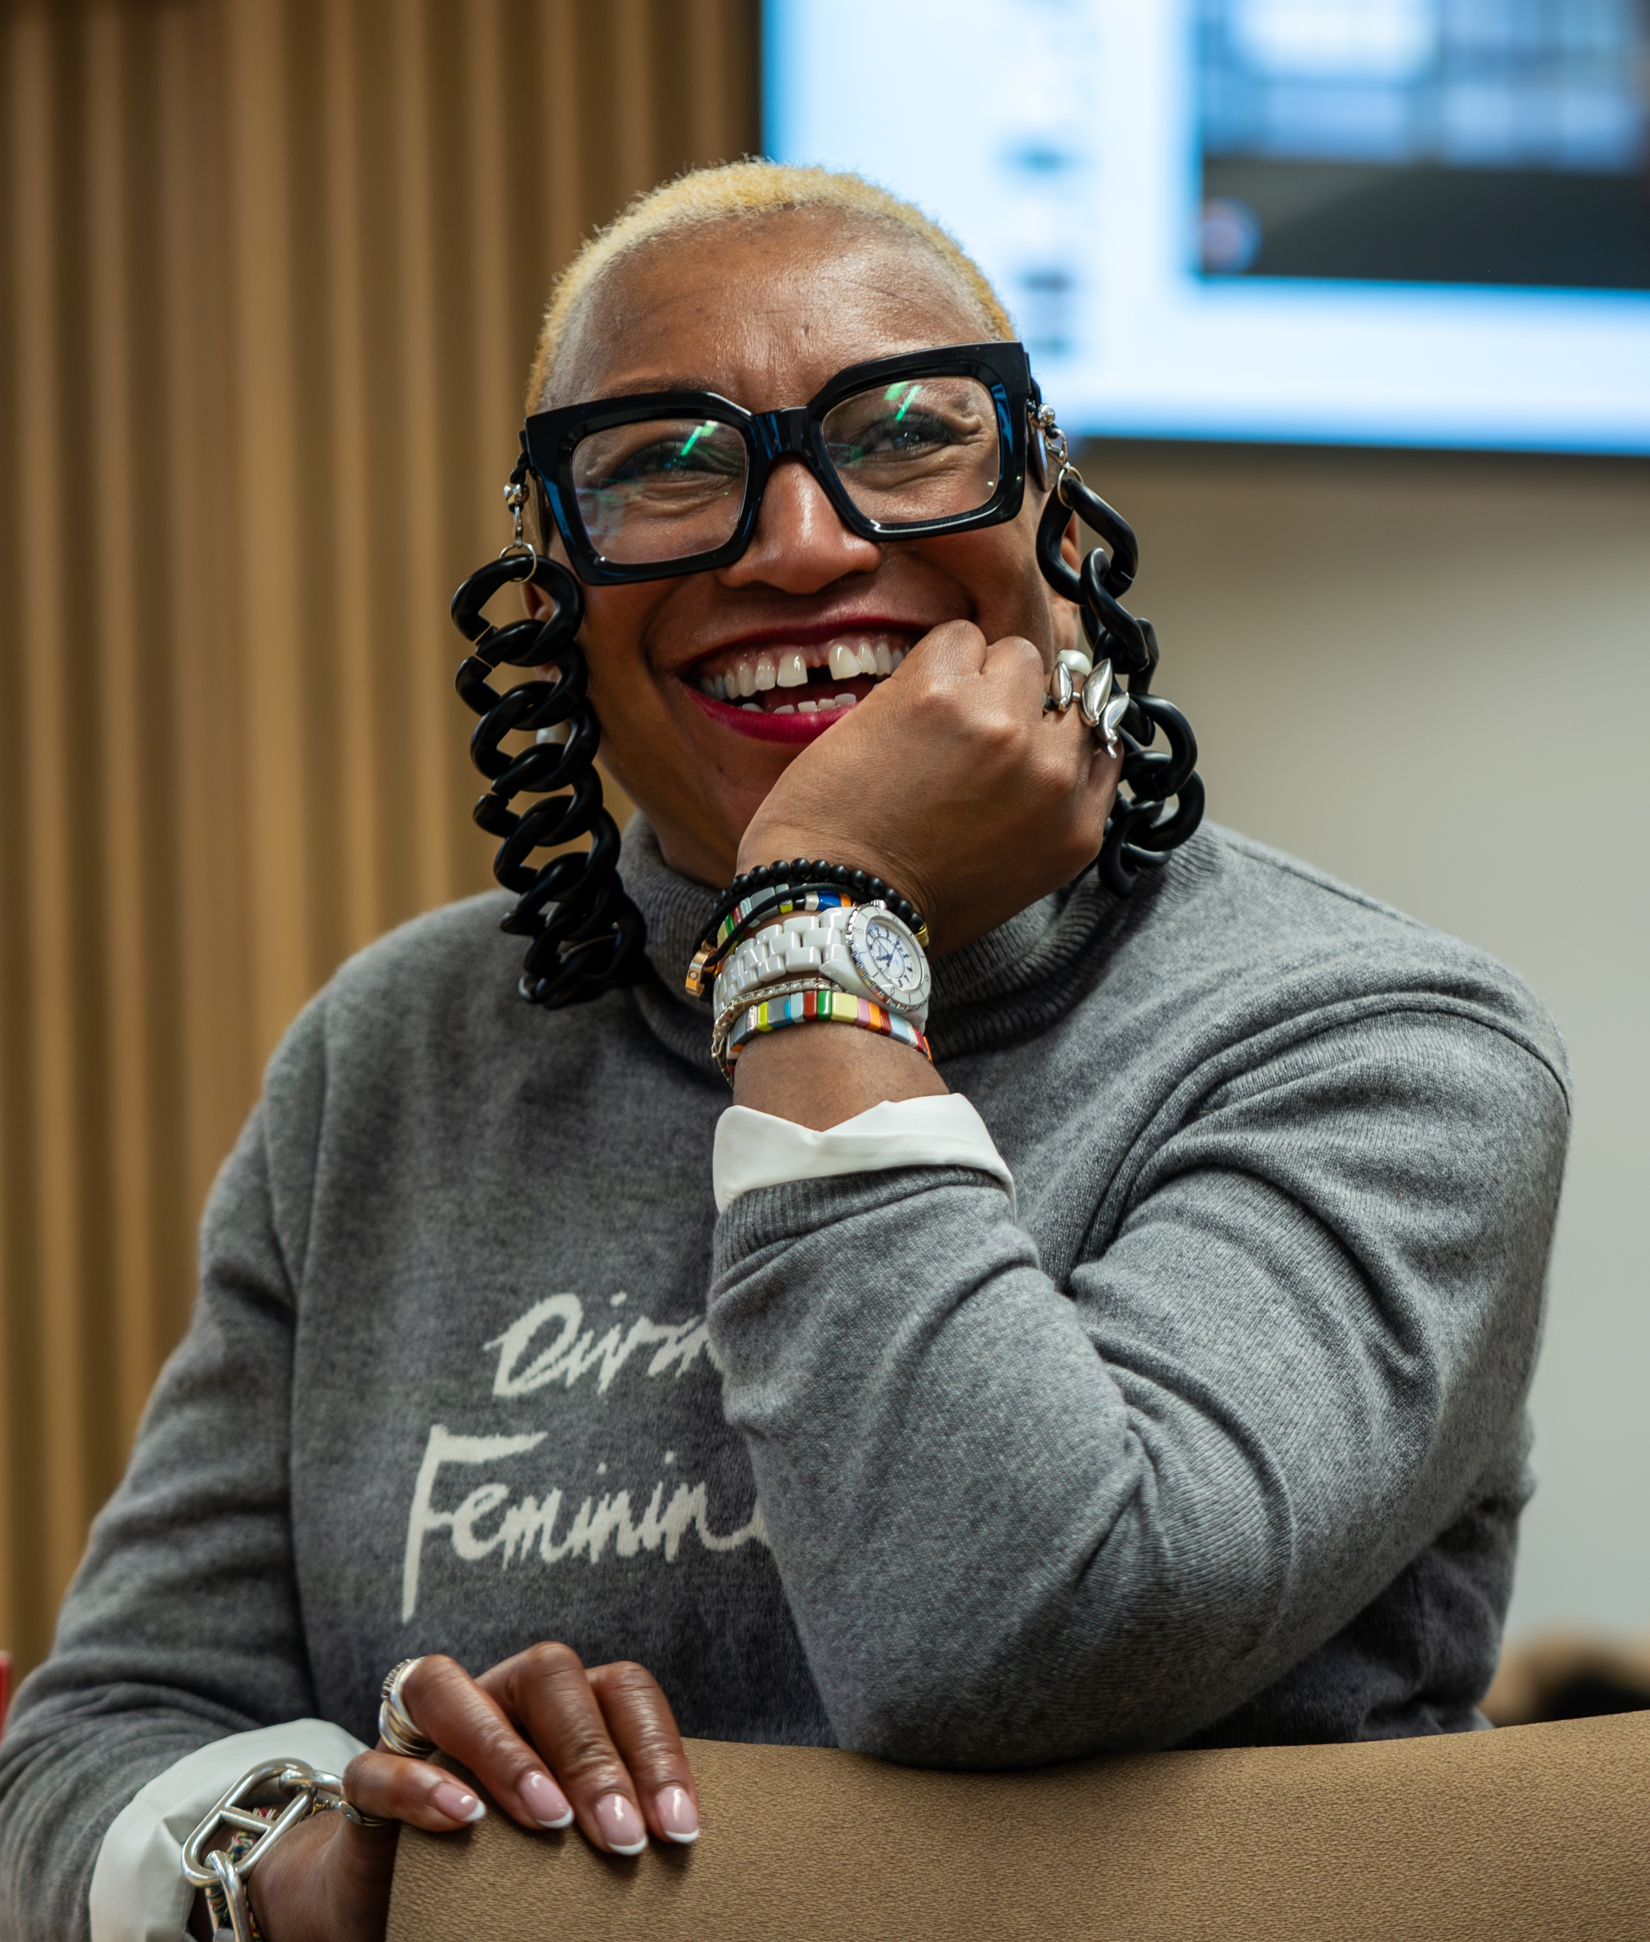
Our Chancellor
Sandie Okoro OBE is our new Chancellor.​
​
A pre-eminent lawyer, equality rights champion and Birmingham graduate, Sandie has made a remarkable contribution to diversity, equality and female rights, and is currently Group General Counsel of ​Standard Chartered.
Notes:
Sandie Okoro - Sandie is a proud University of Birmingham alumna, graduating with a degree in Law and Politics from Birmingham before qualifying as a barrister at City, University of London. After switching roles to solicitor, she held posts including Head of Legal for Corporate Services at Schroders, Global General Counsel at Barings and General Counsel for HSBC Global Asset Management. Sandie was also Senior Vice-President and General Counsel, and Vice-President for Compliance, for the World Bank Group.

Slide 5
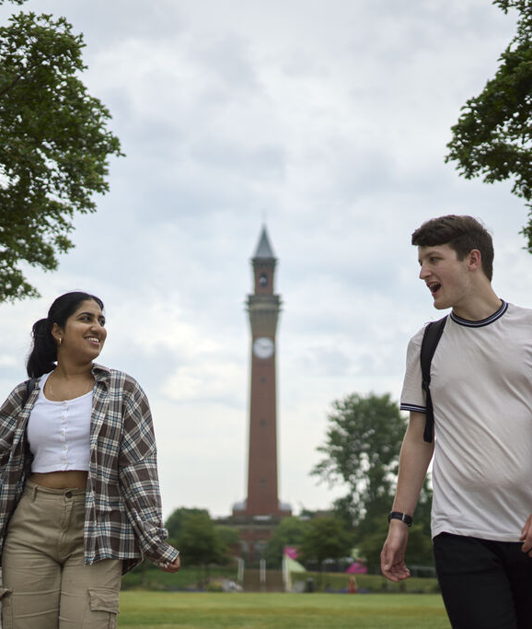

University of the
Year 2027
Source: Daily Mail 2027
Notes:
The University of Birmingham has been named Daily Mail University of the Year 2027, recognising its excellence in student outcomes and experience, educational innovation, and investment in the future.

Slide 6
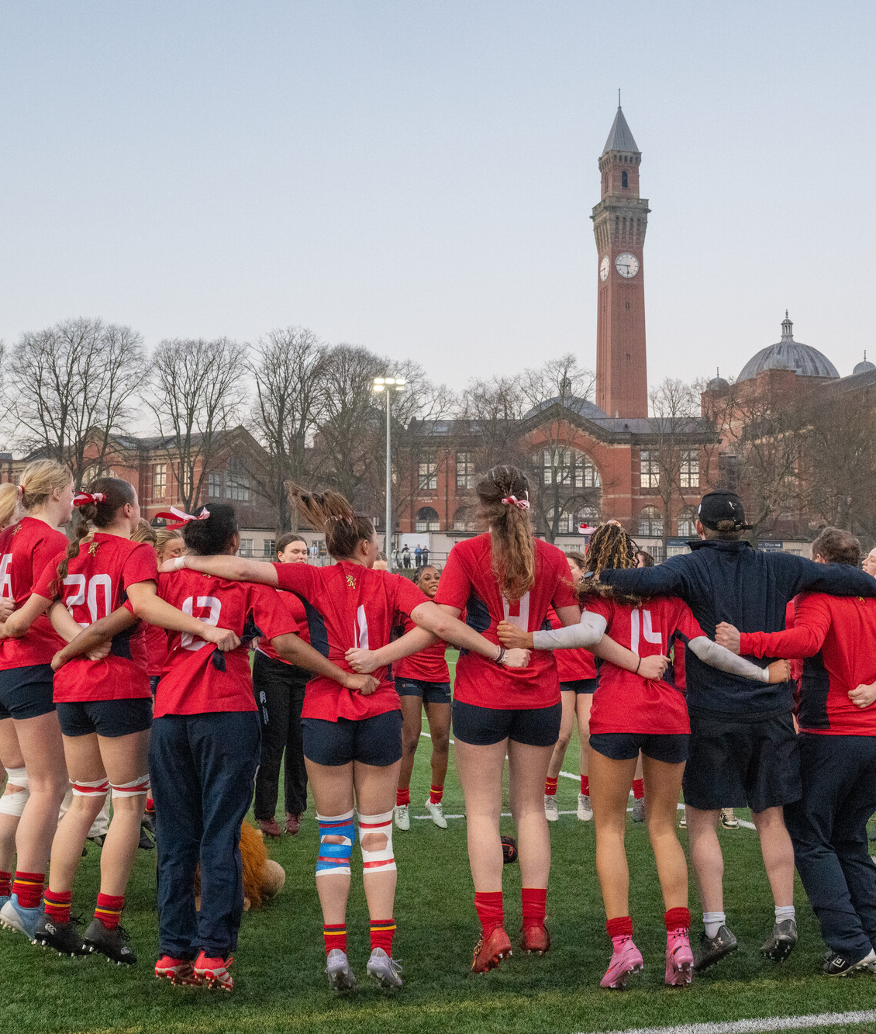

Sport University
of the Year 2027
Source: Times and Sunday Times
Good University Guide 2027
Notes:
The University of Birmingham has been named The Times & Sunday Times Sport University of the Year 2027, recognising its outstanding contribution to sport, athlete development, research, education and community engagement.
The Times & Sunday Times recognition reflects the strength of the University's partnerships across the sporting landscape, including with the PGA, Birmingham City Football Club, and Warwickshire County Cricket Club. These collaborations allow the University to advance athlete performance, sports science, health and wellbeing, while creating new opportunities for students and researchers to work alongside elite sporting organisations.
Birmingham's sporting impact is also reflected in the achievements of its alumni, including Olympic medallist Georgia Hunter Bell, England international swimmer Ollie Morgan, and former world championship medallist and Olympian Hannah England.

Slide 7
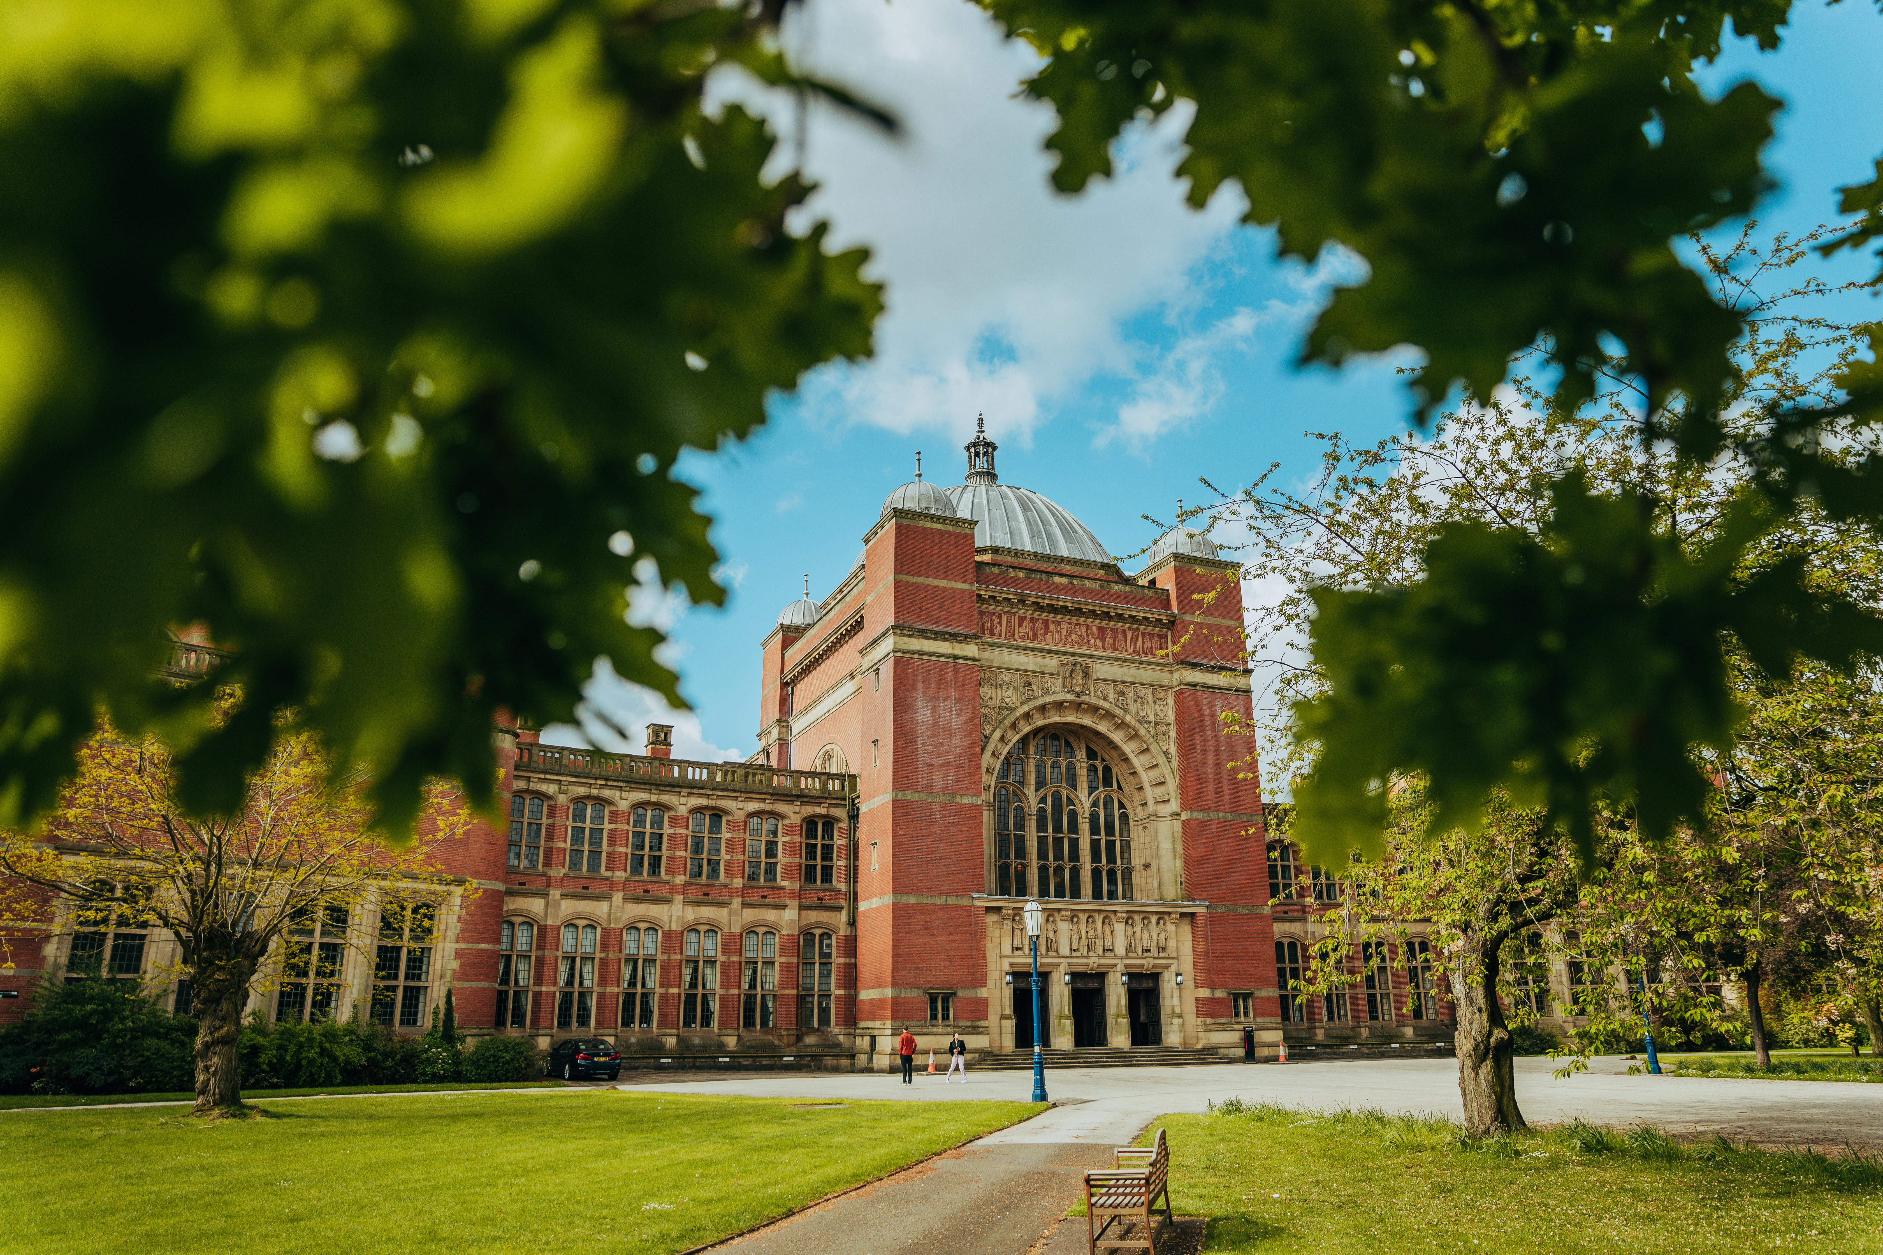

68th in the QS World University Rankings
Source: QS World University Rankings 2027
Notes:
The University of Birmingham has again improved its position amongst the best-performing research-intensive universities in the world – rising eight places in this year’s QS World University Rankings
Now ranked 68th in the prestigious global ranking, which is unveiled in June 2026, the University has achieved an impressive fourth successive year of improvement, and its best performance in a decade. This year’s success follows a four-place rise to 76th in 2025.

Slide 8
Our University in numbers
42,486 students
First in Russell Group for NSS
68th
10
£1bn
One of the top
universities
£250+ million
92%
10th
at both undergraduate and postgraduate
(National Student Survey 2026)
for top graduate employers (High Fliers 2026)
of our research is rated as world-leading or internationally excellent
(REF 2021)
in the world (QS World University Rankings)
Nobel Prize winners
University annual income
in annual external research awards
In the Russell Group for Grade Point Average
(REF 2021)

Slide 9
Our University in numbers
68th
10
£1bn
42,486 students
First in Russell Group for NSS
£250+ million
92%
10th
One of the top
universities
of our research is rated as world-leading or internationally excellent
(REF 2021)
in the world (QS World University Rankings)
Nobel Prize winners
University annual income
at both undergraduate and postgraduate
(National Student Survey 2026)
for top graduate employers (High Fliers 2026)
in annual external research awards
In the Russell Group for Grade Point Average
(REF 2021)

Slide 10
Our University in numbers
10
42,486 students
First in Russell Group for NSS
68th
£1bn
One of the top
universities
£250+ million
92%
12th
at both undergraduate and postgraduate
of our research is rated as world-leading or internationally excellent
(REF 2021)
in the world (QS World University Rankings)
Nobel Prize winners
University annual income
(National Student Survey 2026)
for top graduate employers (High Fliers 2026)
in annual external research awards
in the UK
(Complete University Guide 2027)
in annual external research awards

Slide 11
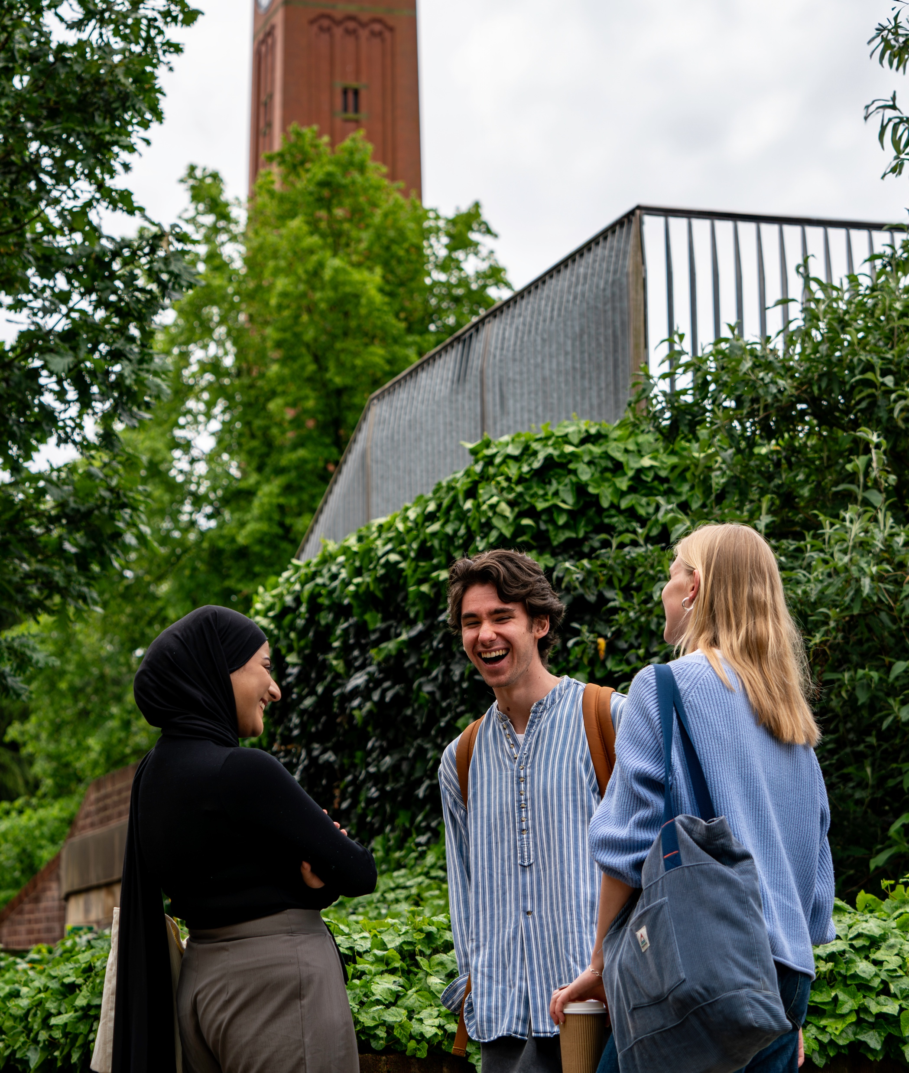
Now is the time
Study at the University of Birmingham
Notes:
Include information on Graduate Attributes:
Intellectually Curious: Self-motivated researchers and learners; engaging in cutting-edge academic disciplines.
Future Focused: Resilient and innovative, with the capacity to enact positive change. Eager to learn, with a commitment to life-long learning and personal development.
Practical Wisdom: Collaborative and engaged, able to act with humility, confidence and good judgement.

Slide 12
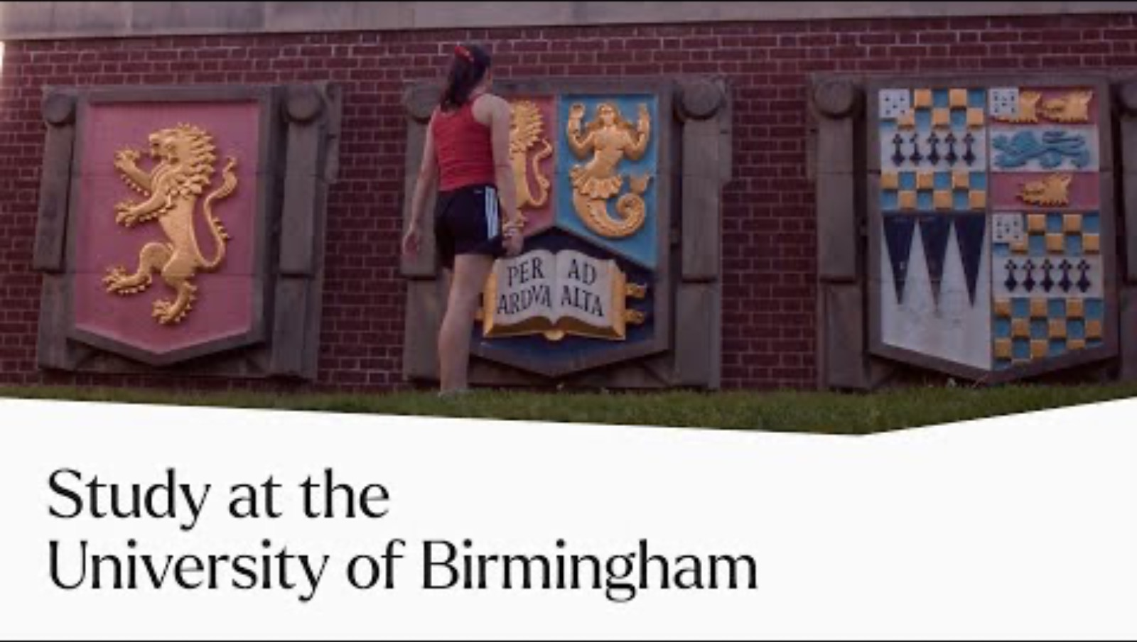

Slide 13
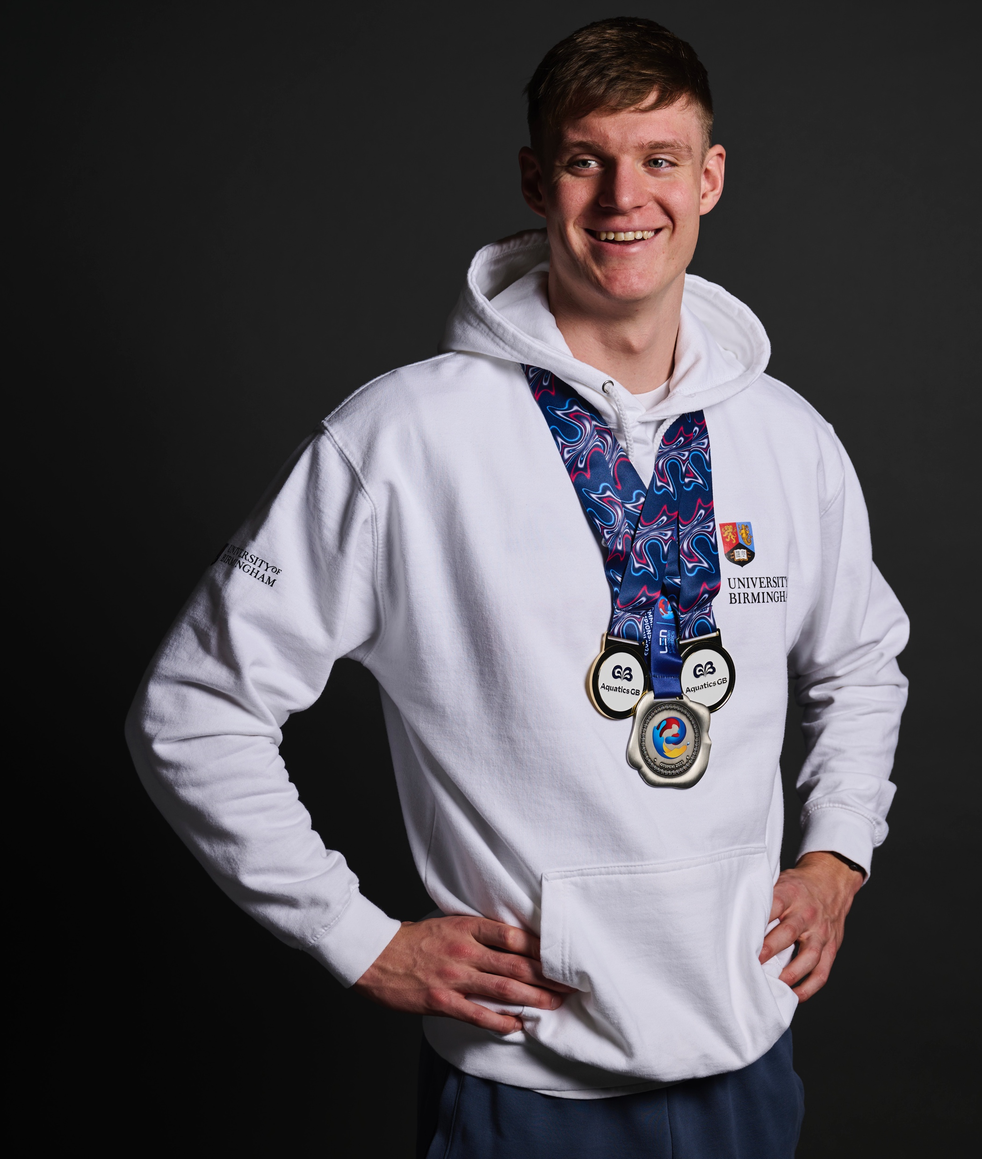
Built in Birmingham.
Forged for
the future..
We are one of the most targeted UK university by top graduate employers
(High Fliers report, The Graduate Market 2024/2025/2026)
Oliver Morgan, Team GB, Paris Olympics 2024

Slide 14
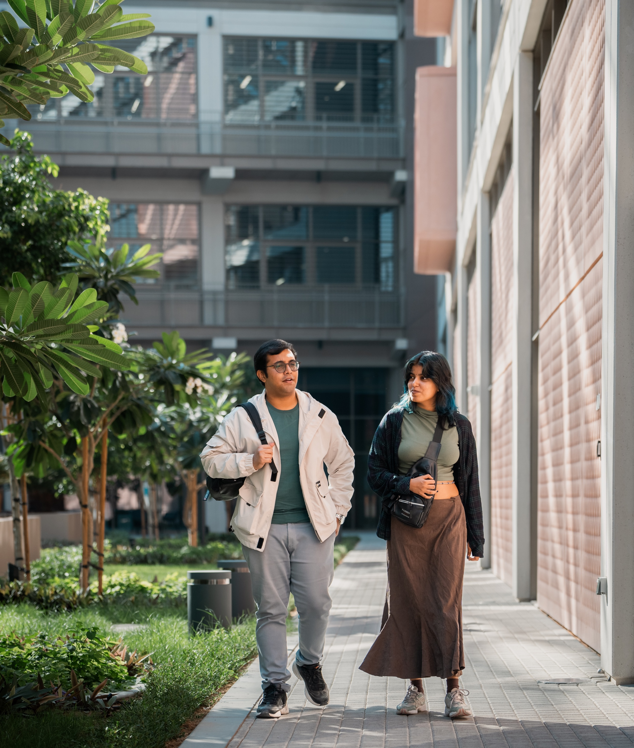
A global university
In 2022 we established our state-of-the-art campus in Dubai furthering our dedication to providing world-leading research and informed university education.
1st Global Top 100 university to open a campus in Dubai
Over 2,000 students
Located in Dubai International
Academic City
Dubai Knowledge Partnership – a leading hub of innovation

Slide 15
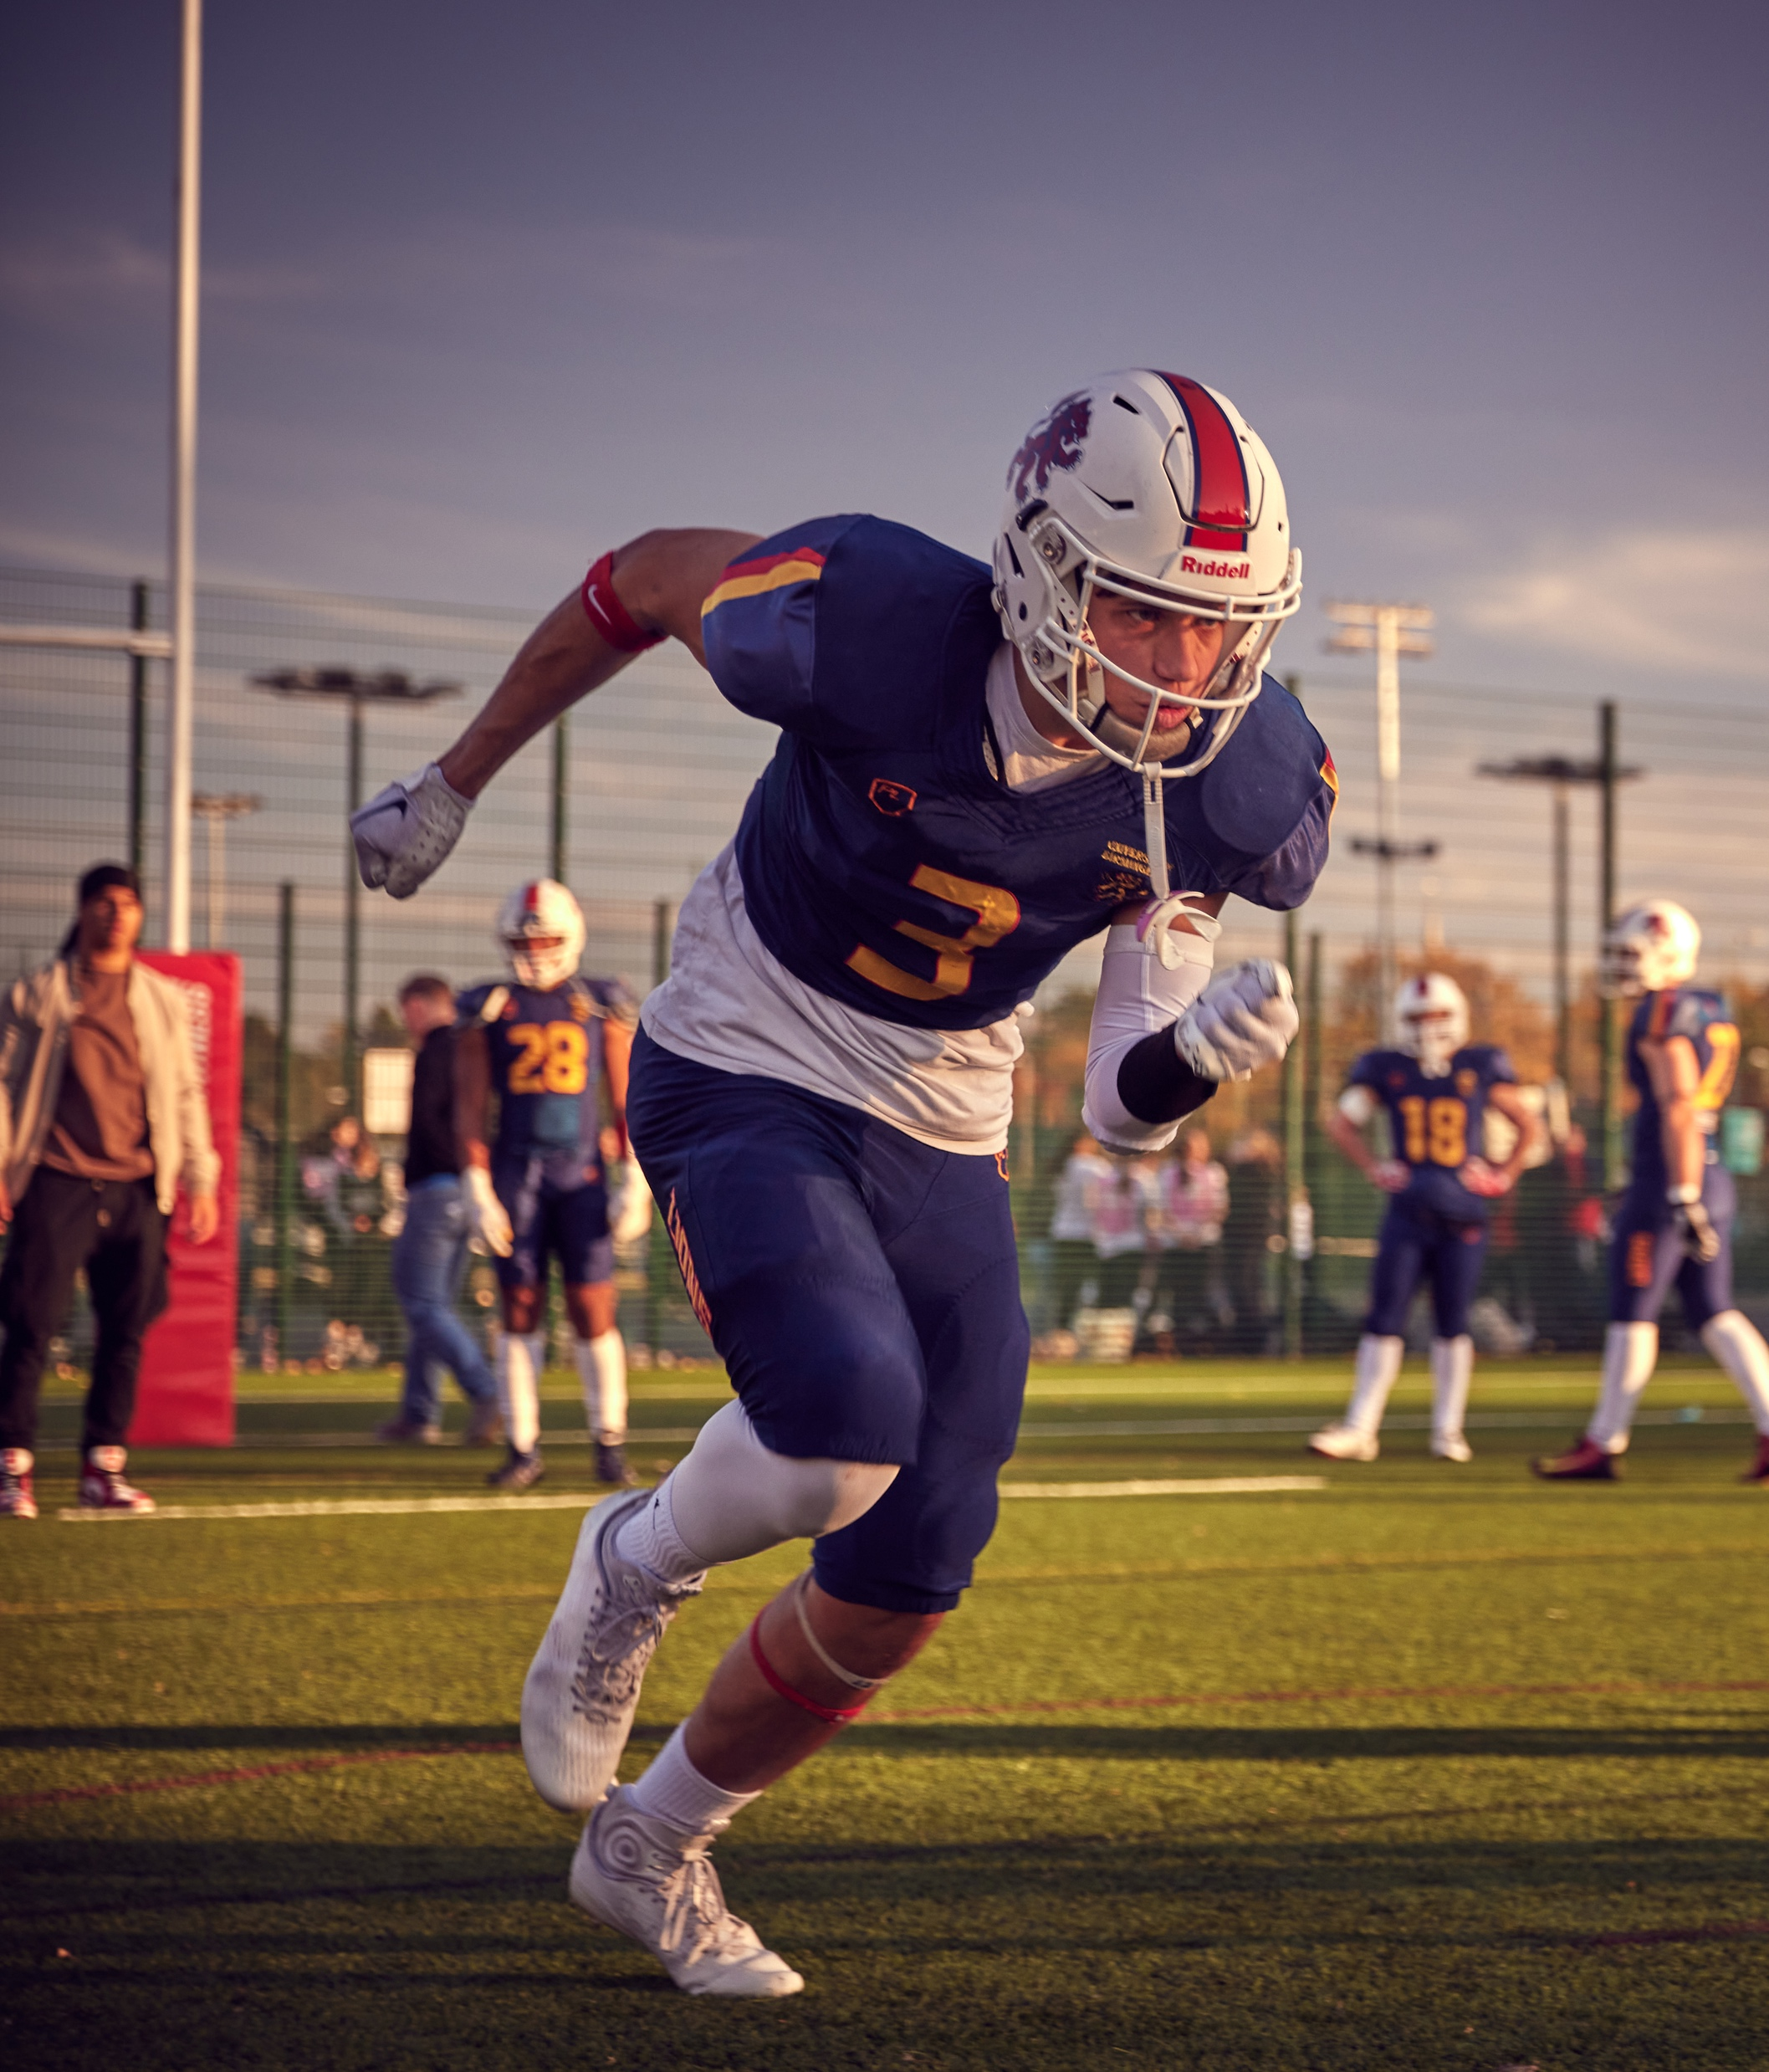
Sport for everyone
Sport brings our diverse community together – whether you’re an elite athlete or just looking to find friends.
62 different sports clubs, from American Football to Ultimate Frisbee
Complete for one of the Top 10 universities for sport in the British University and Colleges Sport (BUCS) leagues
Sports & Fitness club with world class facilities, including a 50-metre pool

Slide 16
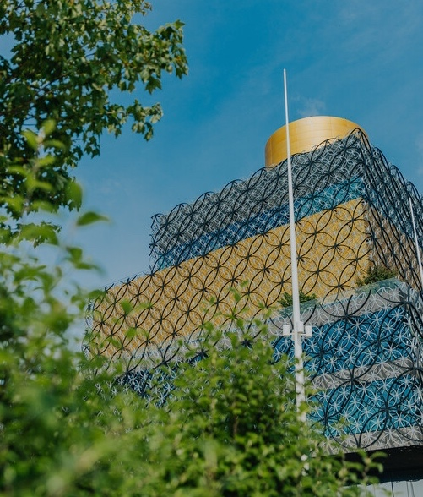
Living in Birmingham
Our cosmopolitan city has a unique history and so much to see and do. It’s no wonder our students fall in love with the city and almost half decide to stay in the region after they graduate.
The UK’s second city, Birmingham is a vibrant place to live, with a rich culture and diverse community.
Birmingham is more than somewhere to study. It’s a place to get future ready.

Slide 17


Our global community
Our relationship with students continues long after they graduate, creating an inclusive and active global community who support the University in our determined efforts to be a force for good.
408,958
107,108
2000
250,000
alumni, creating a
global network
alumni live overseas
alumni made donations
to support scholarships
for students (2023/24)
hours alumni and supporters have volunteered (2023/24)
Notes:
We identify ambassadors and advocates in our international alumni and cultivate philanthropic donors to raise our profile and provide alternative funding streams for our research.
We increase our philanthropic support through influential alumni who play active roles as ambassadors and advocates in advancing the University’s reach and impact.

Slide 18

Changing how the world works
Our five research challenge themes showcase our pioneering breakthroughs, multidisciplinary collaboration, and significant global impact.

Slide 19



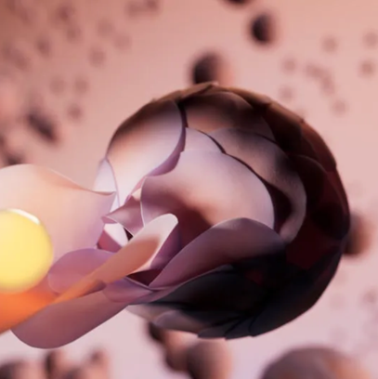

Our research challenge themes
Thriving Planet
Life-Changing
Technologies
Connecting Cultures
Global Health
Fairer World
Improving air quality and access to clean water, and advancing the clean technologies needed to ensure a sustainable future
Improving the health of people across the world through new discoveries, treatments, and patient pathways.
Driving meaningful change to tackle inequalities that permeate society.
Driving innovation with industrial and manufacturing partners, advancing technology and accelerating impact on human progress
Promoting and connecting diverse cultures, fostering social inclusion, shared ownership, and a sense of belonging.

Slide 20
Our research challenge themes
Thriving Planet
Life-Changing
Technologies
Connecting Cultures
Global Health
Fairer World
Improving air quality and access to clean water, and advancing the clean technologies needed to ensure a sustainable future
Improving the health of people across the world through new discoveries, treatments, and patient pathways.
Driving meaningful change to tackle inequalities that permeate society.
Driving innovation with industrial and manufacturing partners, advancing technology and accelerating impact on human progress
Promoting and connecting diverse cultures, fostering social inclusion, shared ownership, and a sense of belonging.

Slide 21


Slide 22
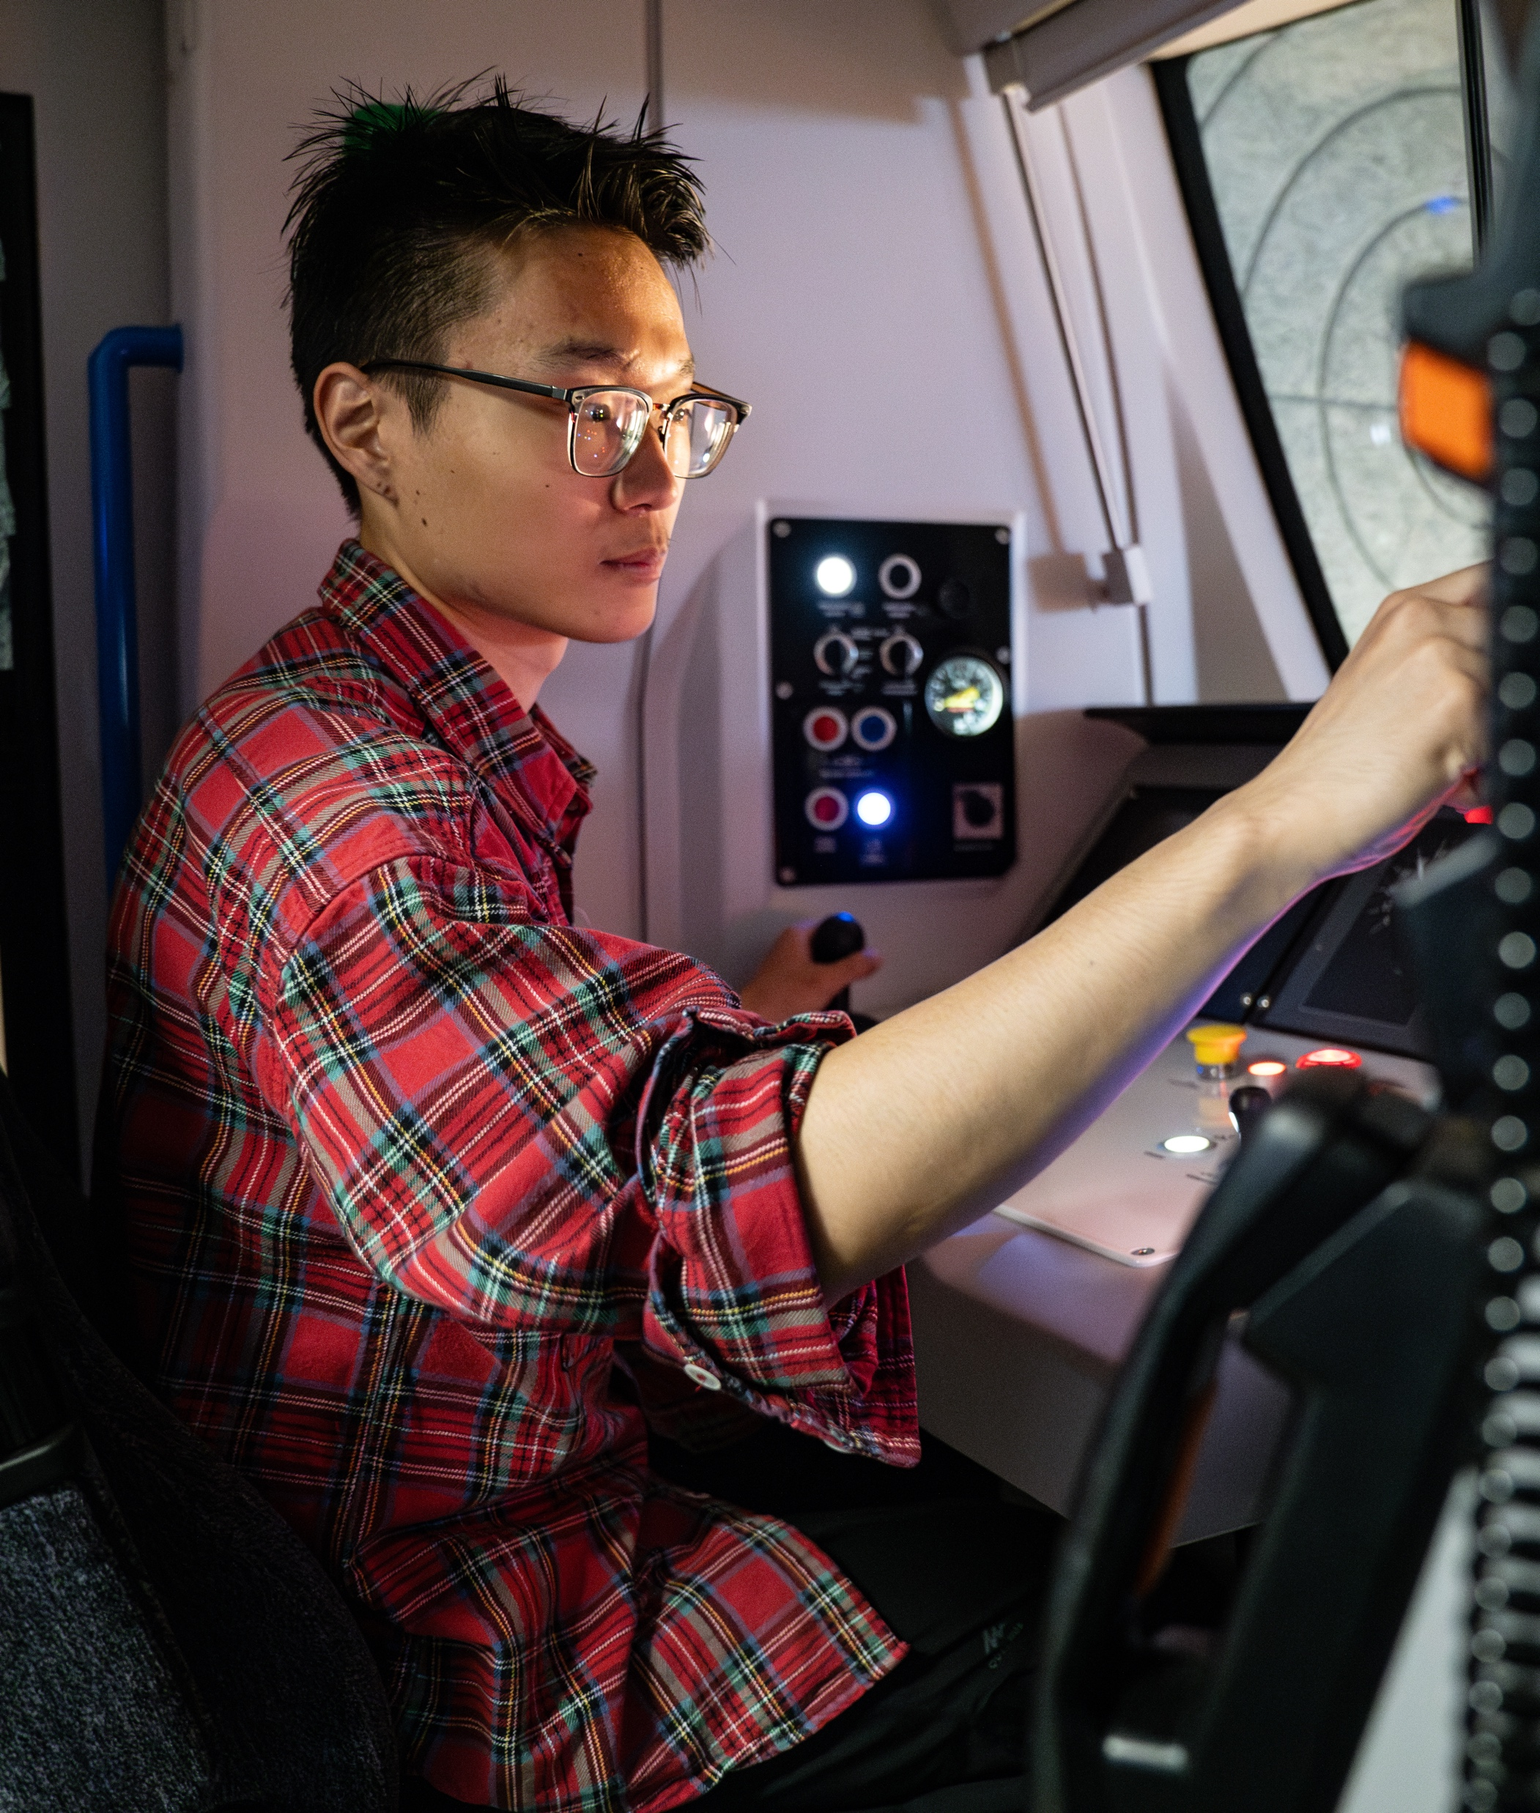
Significant research facilities
Our research facilities drive innovation across energy, healthcare, infrastructure, advanced manufacturing, and much more.
These include:
High Flux Accelerator-Driven Neutron
Quantum Technology Hub
Tyseley Energy Park
Birmingham Health Innovation Campus

Slide 23

Public and Cultural Engagement
Our vision to make Birmingham the most plugged-in university in the world by building strong community connections through education, research, and collaboration.
Public and cultural engagement is central to our work and purpose.

Slide 24
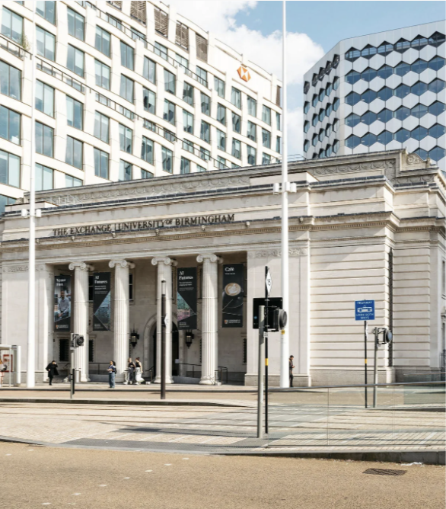
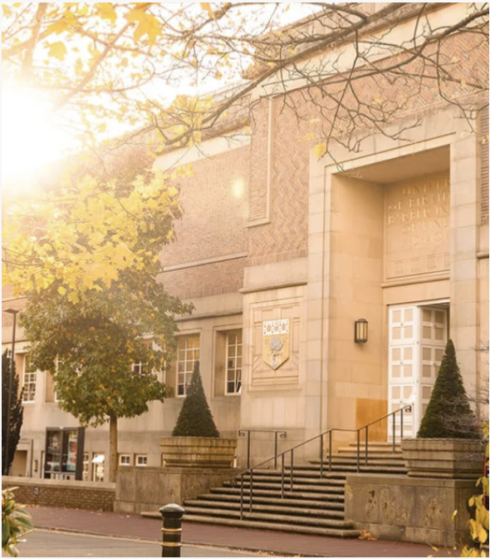
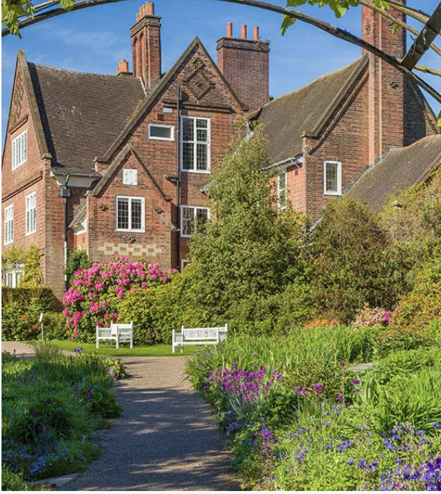
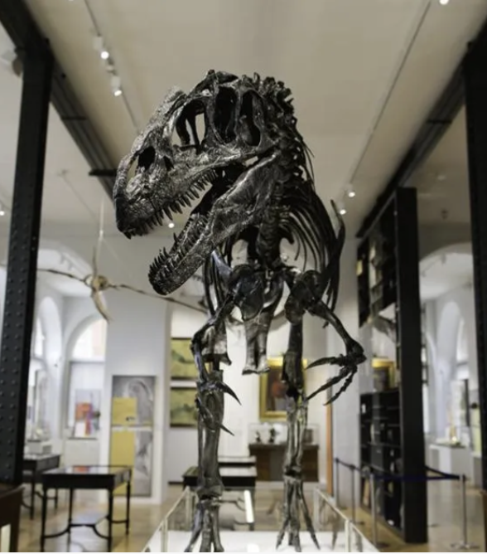

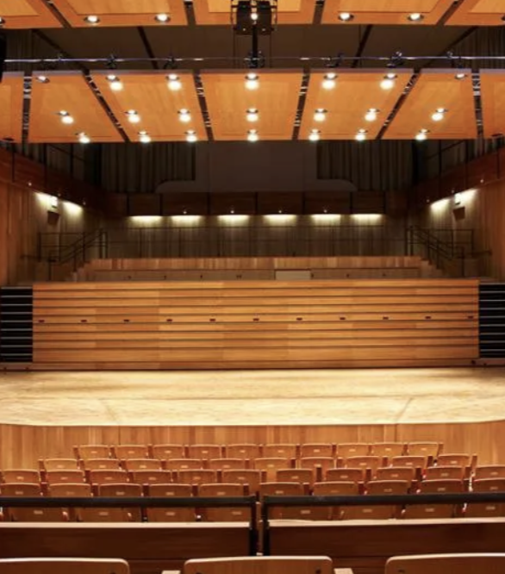
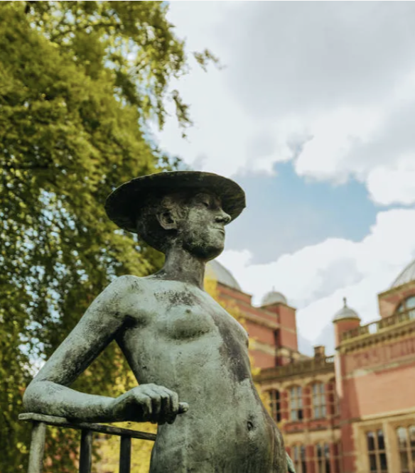
Our cultural destinations
The Exchange
Barber Institute of Fine Art
Winterbourne House and Garden
Lapworth Museum
Cadbury Research Library
Bramall Music Building
Research and Cultural Collections
Our city-centre venue for free exhibitions, activities and events through the lens of University research
A leading art gallery and concert hall within its Grade 1 listed building
From rocks and fossils to volcanoes, earthquakes, and even dinosaurs
Our extensive Special Collections of rare books, manuscripts, archives, photographs and more
State-of-the-art teaching and performance spaces, we attract visitors and artists from across the world
Experience an Edwardian historic house and garden nestled in a leafy corner of Birmingham
Our city-centre venue for free exhibitions, activities and events through the lens of University research
Notes:
We have a wealth of cultural artefacts on campus, which is alive with performance facilities and fine art, renowned collections and archives, spanning literature, history, arts and religion.​

Slide 25
Our cultural destinations
The Exchange
Barber Institute of Fine Art
Winterbourne House and Garden
Lapworth Museum
Cadbury Research Library
Bramall Music Building
Research and Cultural Collections
Our city-centre venue for free exhibitions, activities and events through the lens of University research
A leading art gallery and concert hall within its Grade 1 listed building
From rocks and fossils to volcanoes, earthquakes, and even dinosaurs
Our extensive Special Collections of rare books, manuscripts, archives, photographs and more
State-of-the-art teaching and performance spaces, we attract visitors and artists from across the world
Experience an Edwardian historic house and garden nestled in a leafy corner of Birmingham
Our city-centre venue for free exhibitions, activities and events through the lens of University research

Slide 26
Our cultural destinations
The Exchange
Barber Institute of Fine Art
Winterbourne House and Garden
Lapworth Museum
Cadbury Research Library
Bramall Music Building
Research and Cultural Collections
Our city-centre venue for free exhibitions, activities and events through the lens of University research
A leading art gallery and concert hall within its Grad—1 listed building
From rocks and fossils to volcanoes, earthquakes, and even dinosaurs
Our extensive Special Collections of rare books, manuscripts, archives, photographs and more
State-of-the-art teaching and performance spaces, we attract visitors and artists from across the world
Experience an Edwardian historic house and garden nestled in a leafy corner of Birmingham
Our city-centre venue for free exhibitions, activities and events through the lens of University research

Slide 27
Nobel Prize Winners
We have been conducting research that matters for 125 years.
1982
2001
2016
Physiology or Medicine
Physiology or
Medicine
Physics
1922
1937
Chemistry
Nobel Peace
Discoveries of the properties of matter
Professor David J. Thoules & Professor Mike Kosterlitz
Discovering Isotypes
Professor Francis A Aston
Founding the League of Nations
Lord Robert Cecil
Discovery of the
structure of DNA
Maurice Wilkins
Inspiring Cancer Treatments
Professor Sir Paul Nurse
1937
1960
1982
2016
Chemistry
Physiology or
Medicine
Medicine
Chemistry
Discovering synthesizing vitamin C
Professor Sir W. Norman Haworth
Understanding Pain Relief: Aspirin
Professor Sir John Vane
Pioneering Molecular Machines
Professor Sir J. Fraser Stoddart
Pioneering Organ Transplants
Professor Sir Peter Medewar

Slide 28
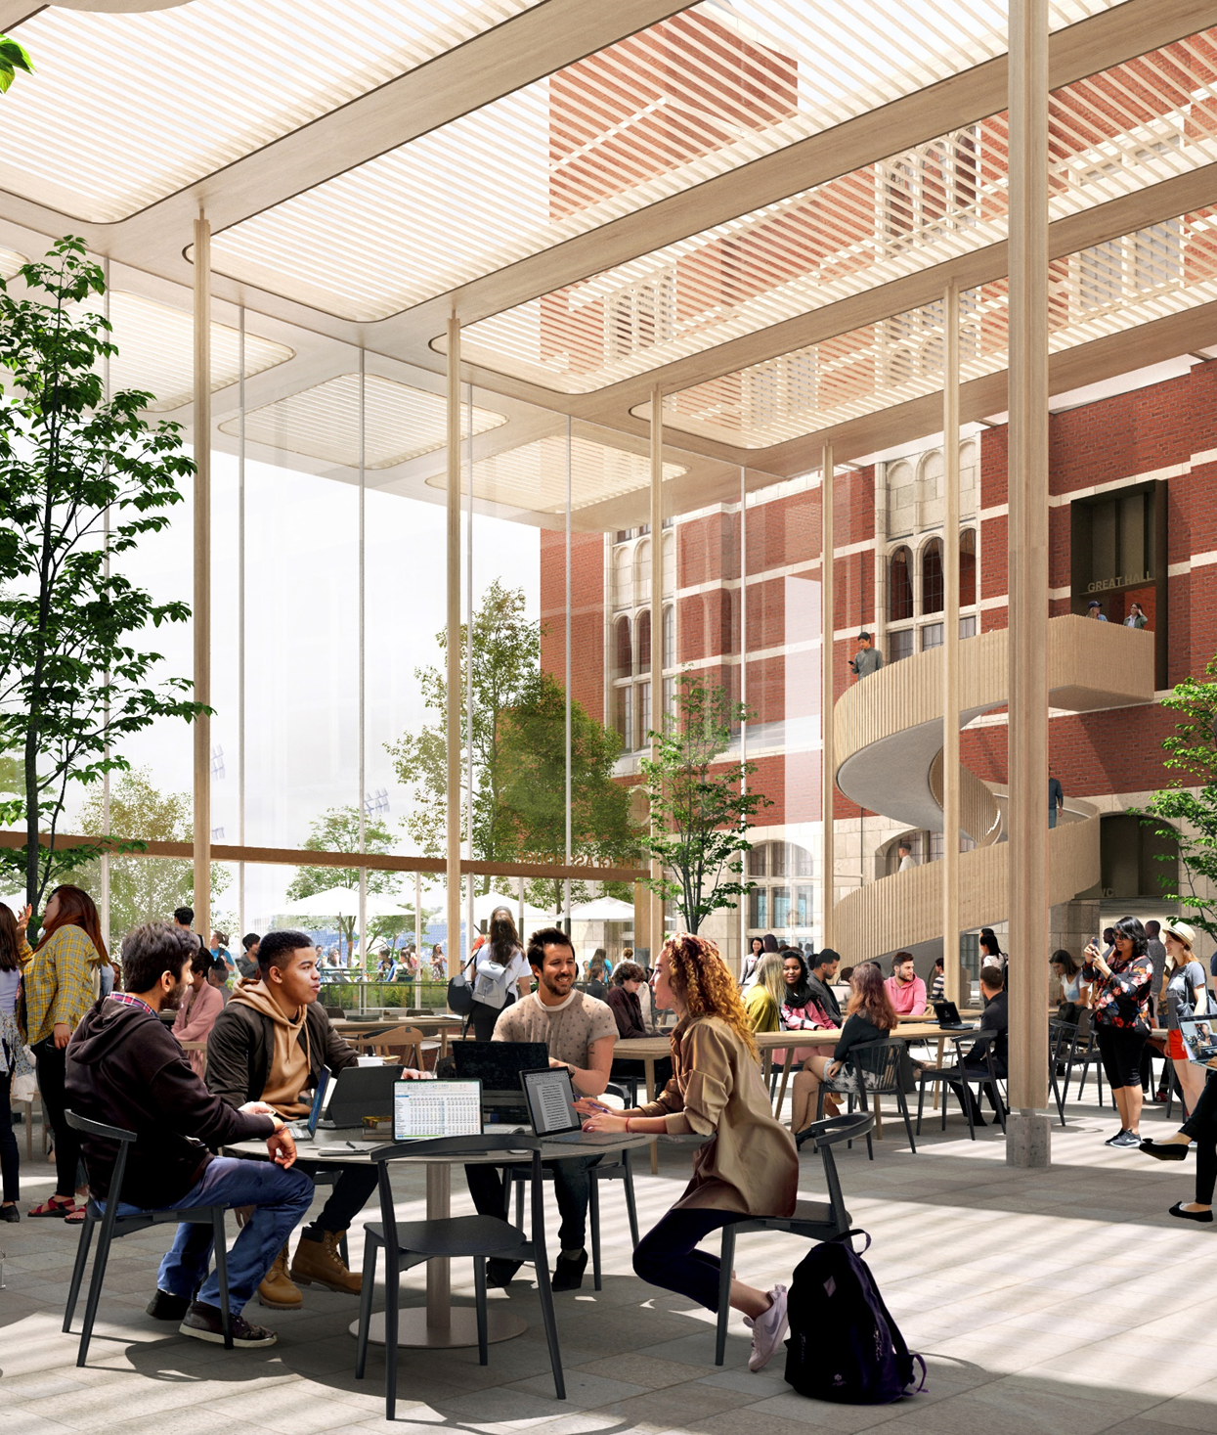
A vision for the campus
We have invested over £600m in our campus since 2016, and we’ve now set out a vision of how it can be developed over the next two decades.
Advancing our research, enhancing our education and strengthening our residential offer, this will develop an even more vibrant, accessible, inclusive and sustainable environment for our communities.

Slide 29
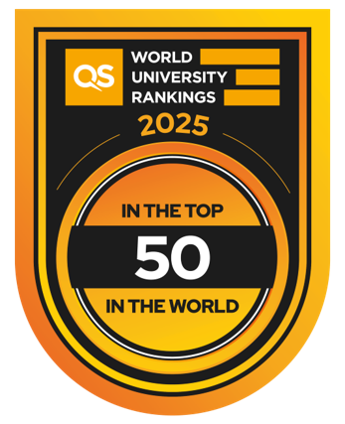






An ambitious strategy for 2030
Notes:
Our six pillars:
Research that matters
Our Birmingham 2030 goals are to:
Grow our research excellence by increasing the number and scale of our globally-recognised research themes.
Deliver research that matters more, with far-reaching impact.
Influence and respond to regional, national and international research priorities.
Increase and diversify research funding to enable more ambitious and impactful research.
Education for sustainable futures
Our Birmingham 2030 goals are to:
Develop a distinctive research-intensive approach to education.
Provide students with a transformative education.
Support a thriving, inclusive, and global student community.
Nurture an environment which values outstanding and innovative teaching.
Engagement and impact
Our Birmingham 2030 goals are to:
Become the best university in the UK for innovation, capitalising on our distinctive breadth of disciplines and innovation sites.
Actively engage our local communities to enhance our education and research.
Equip our students to make a difference in the world throughout their lives.
Civic and global
Our Birmingham 2030 goals are to:
Welcome the best international students, staff, and partners to Birmingham and our global locations.
Take the best of Birmingham to the world, expanding our local, national, and global partnerships.
Make a major contribution to our city and each of the regions in which we operate.
People and culture
Our Birmingham 2030 goals are:
Attract, develop and retain great people.
Promote an intellectually stimulating and collaborative environment for research and education.
Nurture a culture that provides opportunities for all to flourish and succeed.
Sustainability
Our Birmingham 2030 goals are to:
Use our research and education to make a major global contribution to the UN Sustainable Development Goals.
Collaborate with the Birmingham, Dubai, and their wider regions to tackle sustainability.
Achieve net zero carbon for scope 1 and 2 by 2035, and overall by 2045.

Slide 30
Thank you

