Slide 1
Graduate Attributes

Slide 2
Graduate Attributes

Slide 3
Educational Excellence

Slide 4
First choice for employers
University of Birmingham is the top choice for the UK’s major employers searching for graduate recruits according to the 2024 High Fliers report.
Hsu Sint, BSc Accounting and Finance

Slide 5
Introducing our Graduate Attributes
Intellectually Curious
Future Focused
Practical Wisdom
Self-motivated researchers and learners; engaging in cutting-edge academic disciplines.
Resilient and innovative, with the capacity to enact positive change. Eager to learn, with a commitment to life-long learning and personal development.
Collaborative and engaged, able to act with humility, confidence and good judgement.
Subject specialists
Critical and creative thinkers
Interdisciplinary
Instinctively digital
Sustainability focused
Entrepreneurial spirit
Socially engaged
Natural collaborators
Courageous integrity
Notes:
Socially engaged
Natural collaborators
Courageous integrity

Slide 6
Graduate Attributes: For study, work, and life
The skills and qualities students should develop during their time here
High value for employers
Our responsibility to offer quality learning experiences, in and out of the curriculum
Priority to support students in developing these attributes
Student responsibility to make the most of these opportunities
Gain employment, to have a fulfilling career, and to live a flourishing life

Slide 7
Intellectually Curious
Mazeenath Royal,
BA Education

Slide 8
Intellectually Curious
Self-motivated researchers and learners; engaging in cutting-edge academic disciplines.
Subject specialists
Experts in discipline-specific knowledge and enquiry-informed practices.
Critical and creative thinkers
Analytical and independent reflective thinkers.
Charlie Crofts,
BA French and Spanish
Interdisciplinary
Possessing a breadth of knowledge beyond their specialist subject that is shared with others.

Slide 9
Future Focused
Mohammad Hameed-Ali, MEng Civil Engineering

Slide 10
Future Focused
Resilient and innovative in activation of positive change with a commitment to lifelong learning and personal development.
Instinctively digital
Ability to use and evaluate new and emerging digital technologies.
Sustainability focused
Committed to sustainable development in every aspect of life.
Entrepreneurial spirit
Creative with the ability to generate ideas and lead change that benefits others.
Ester Konecna,
BSc Environmental Science

Slide 11
Practical Wisdom
Baljodh Singh, MPharm Pharmacy

Slide 12
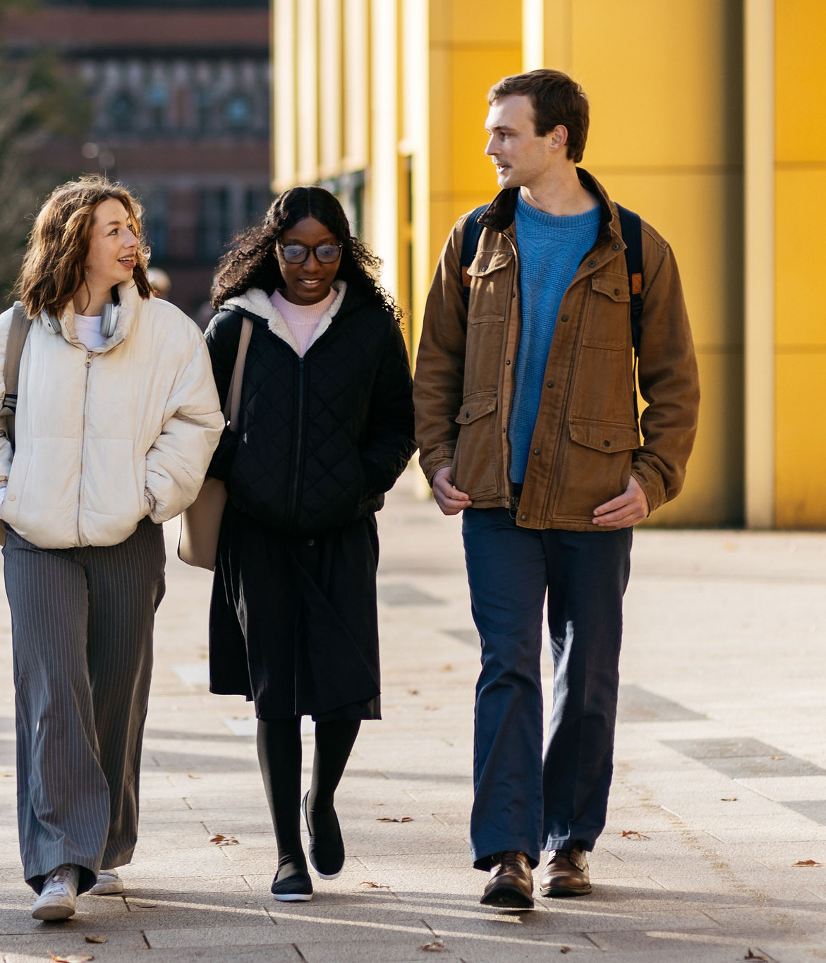
Practical Wisdom
Acting with humility, confidence, and good judgement to do the right thing at the right time.
Socially engaged
Actively helps others and the wider community to flourish.
Natural collaborators
Works collaboratively and can communicate with diverse audiences. Removes barriers for people who are different from themselves.
Courageous integrity
Takes important actions despite the risk of adverse consequences. Committed to truth and acts in alignment with moral principles.

Slide 13
Jonathan is a creative and critical thinker with interdisciplinary expertise across subjects and sectors. They are digitally savvy, entrepreneurial, and practical, embodying lifelong learning, social engagement, collaboration, and integrity.
Jonathan Sill, MEng Mechanical Engineering

Slide 14
Built in Birmingham. Forged for the future.
Ioana Stanescu, BSc Psychology

